Slide 1
Importing an existing model into Groundwater Vistas – GW1876 February 2020
Someone sends you a MODFLOW Model and wants you to hook it up to parameter estimation. The most robust way to base the translation are the native MODFLOW input files; MODFLOW has a defined structure (“Read and Prepare”) that allows for unambiguous connection of many model characteristics for GUIs and helper software like Flopy. But not all. Here is a workflow for bringing in a Flopy derived version of the Freyberg 2.0 model into Groundwater Vistas 7 and do a quick check.
Here is a walk through of all the steps that we did in class.
The directory the base model is: ..\activities_stpete\base_model_files\freyberg.nam

Slide 2
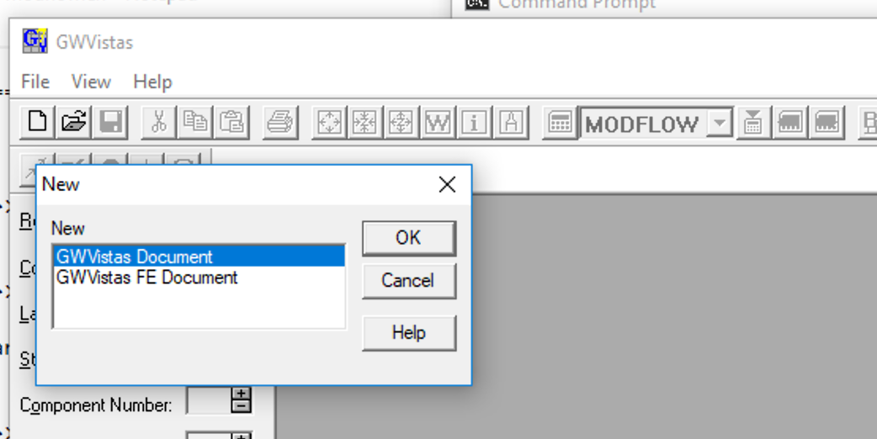
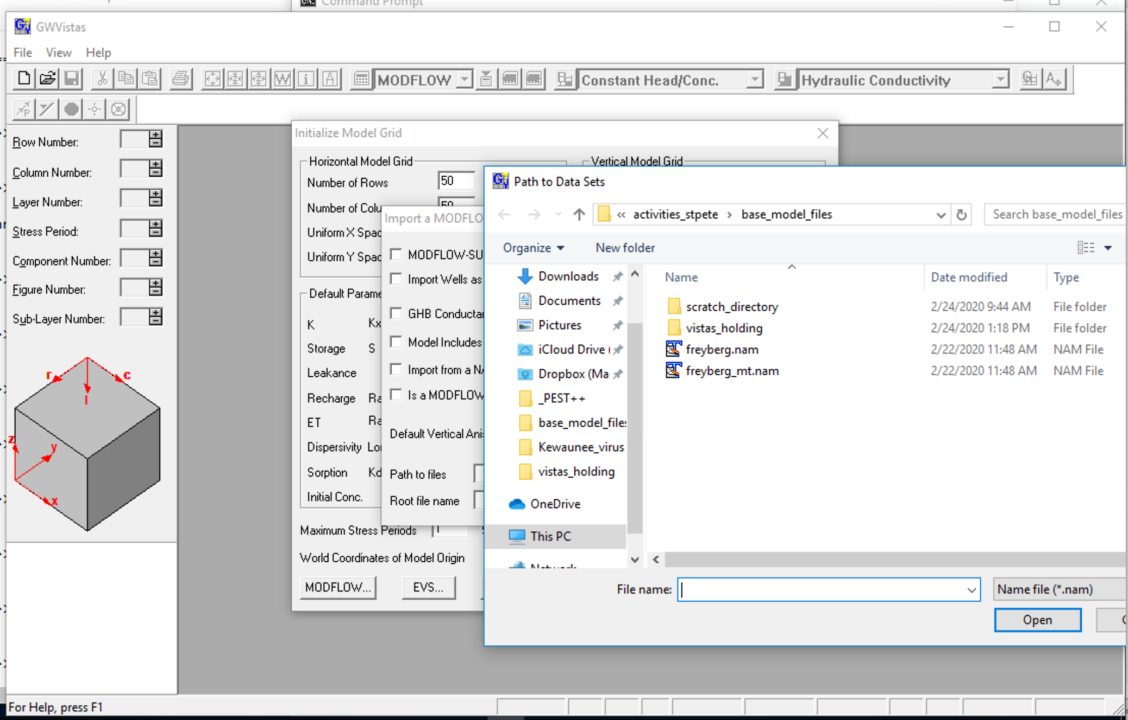
1) File -> New GWVistas Document
2) Browse to find the *.nam file of what you want to import
1

Slide 3
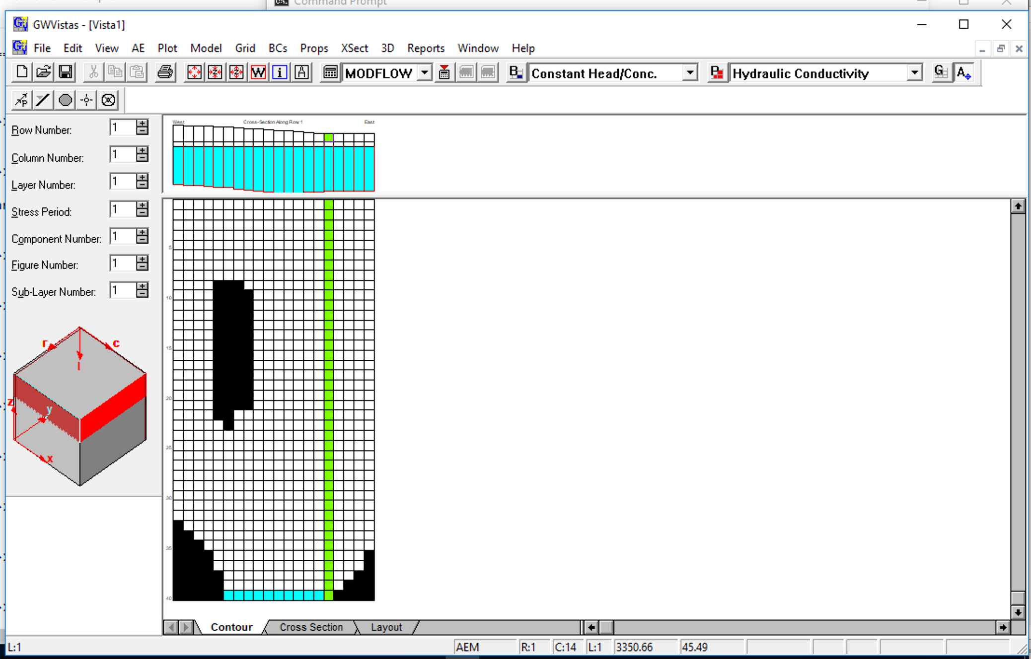
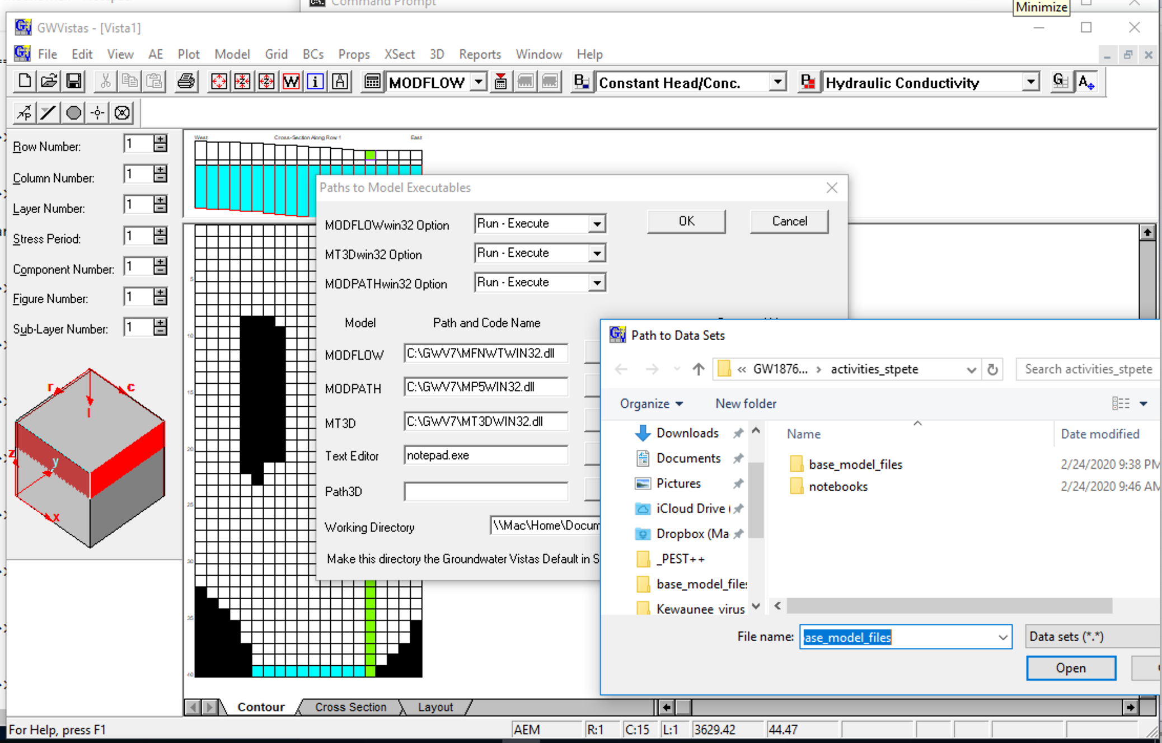
3) What you see after importing Freyberg 2.0
4) Change working directory so don’t overwrite originals
4) Reset conflicting MODFLOW Unit #31

Slide 4
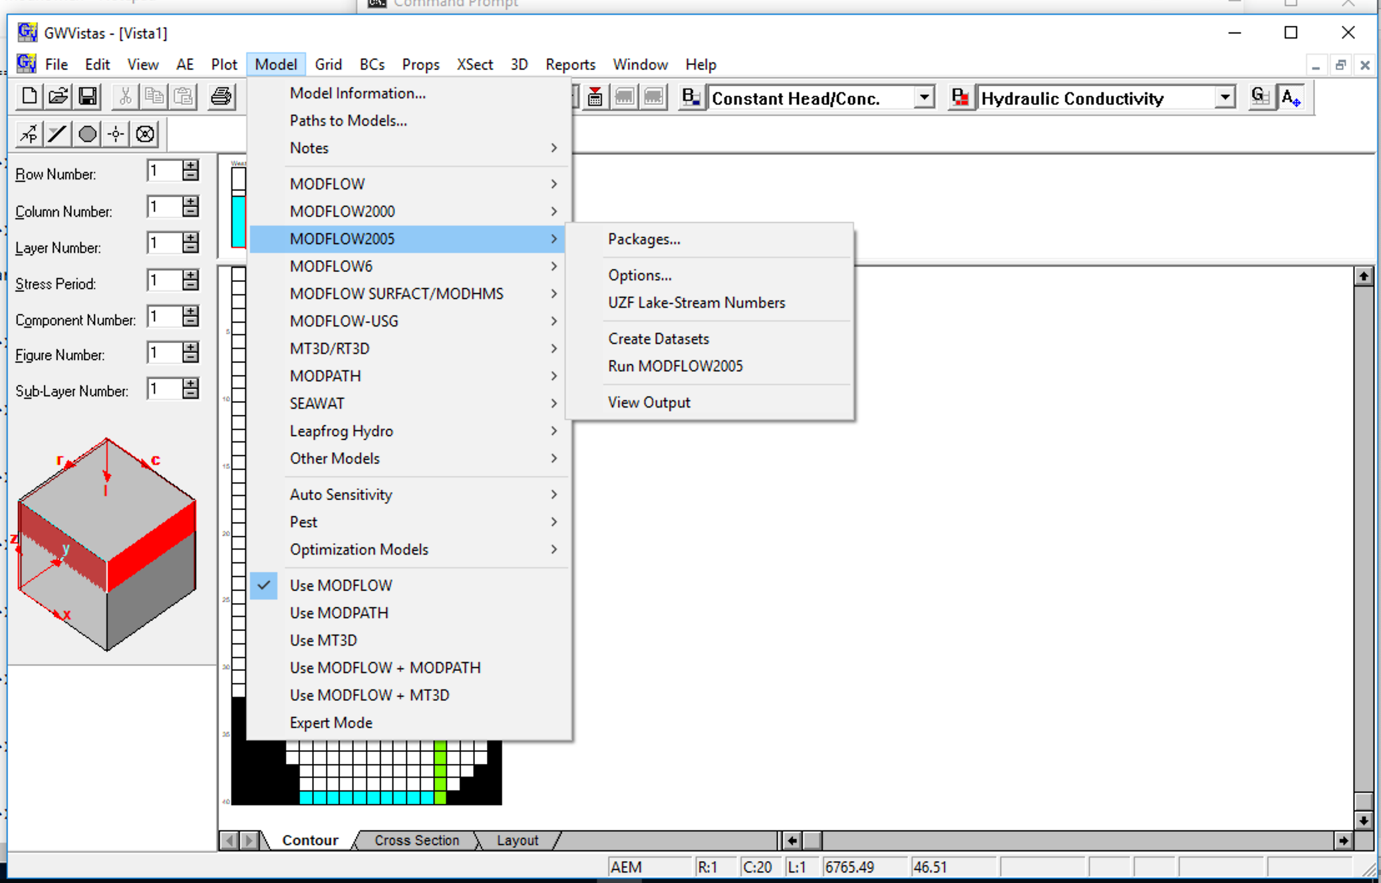
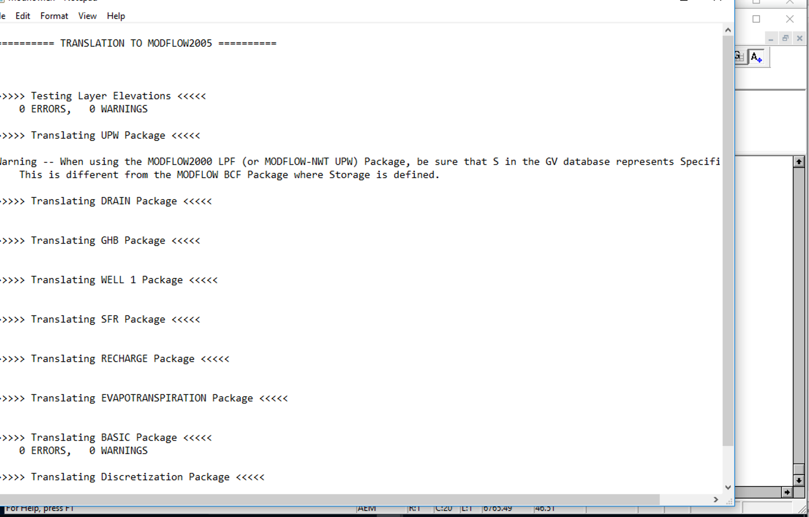
5) Check the import by creating MODFLOW files and seeing if errors/warnings and try to run

Slide 5
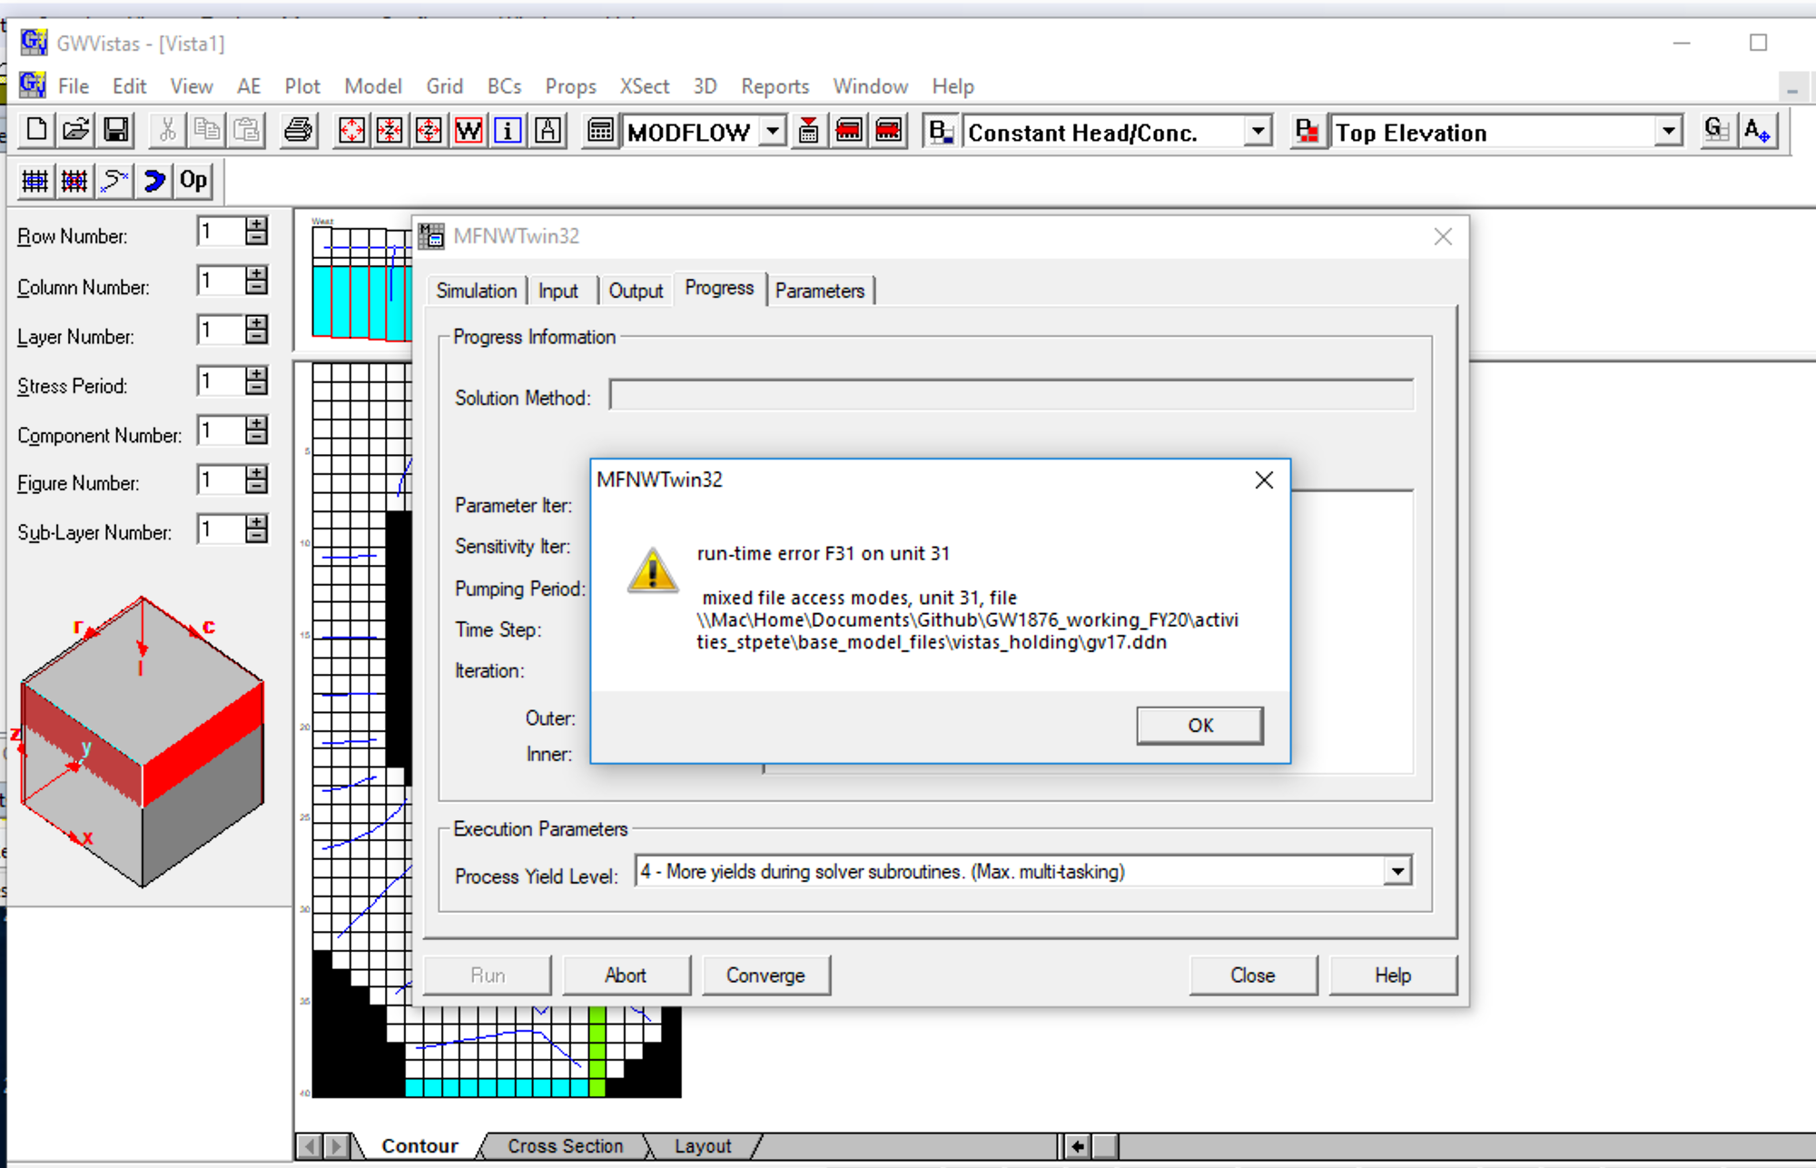
Oh oh – conflict with MODFLOW logical unit 31 – two files are assigned but only one can be. Flopy does know that Unit 31 has traditionally been assigned to drawdown output. GWV7 will exit rather abruptly and steps 1-5 will have to be redone.

Slide 6
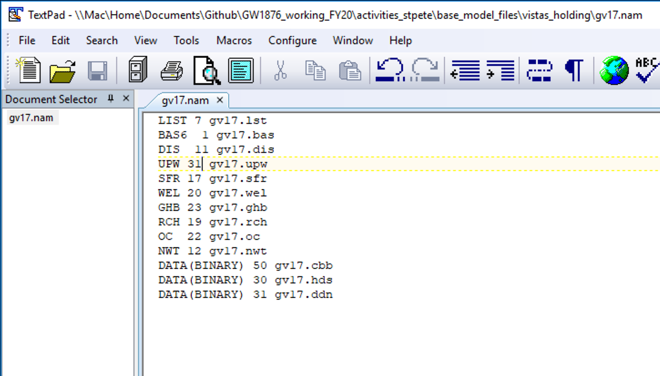
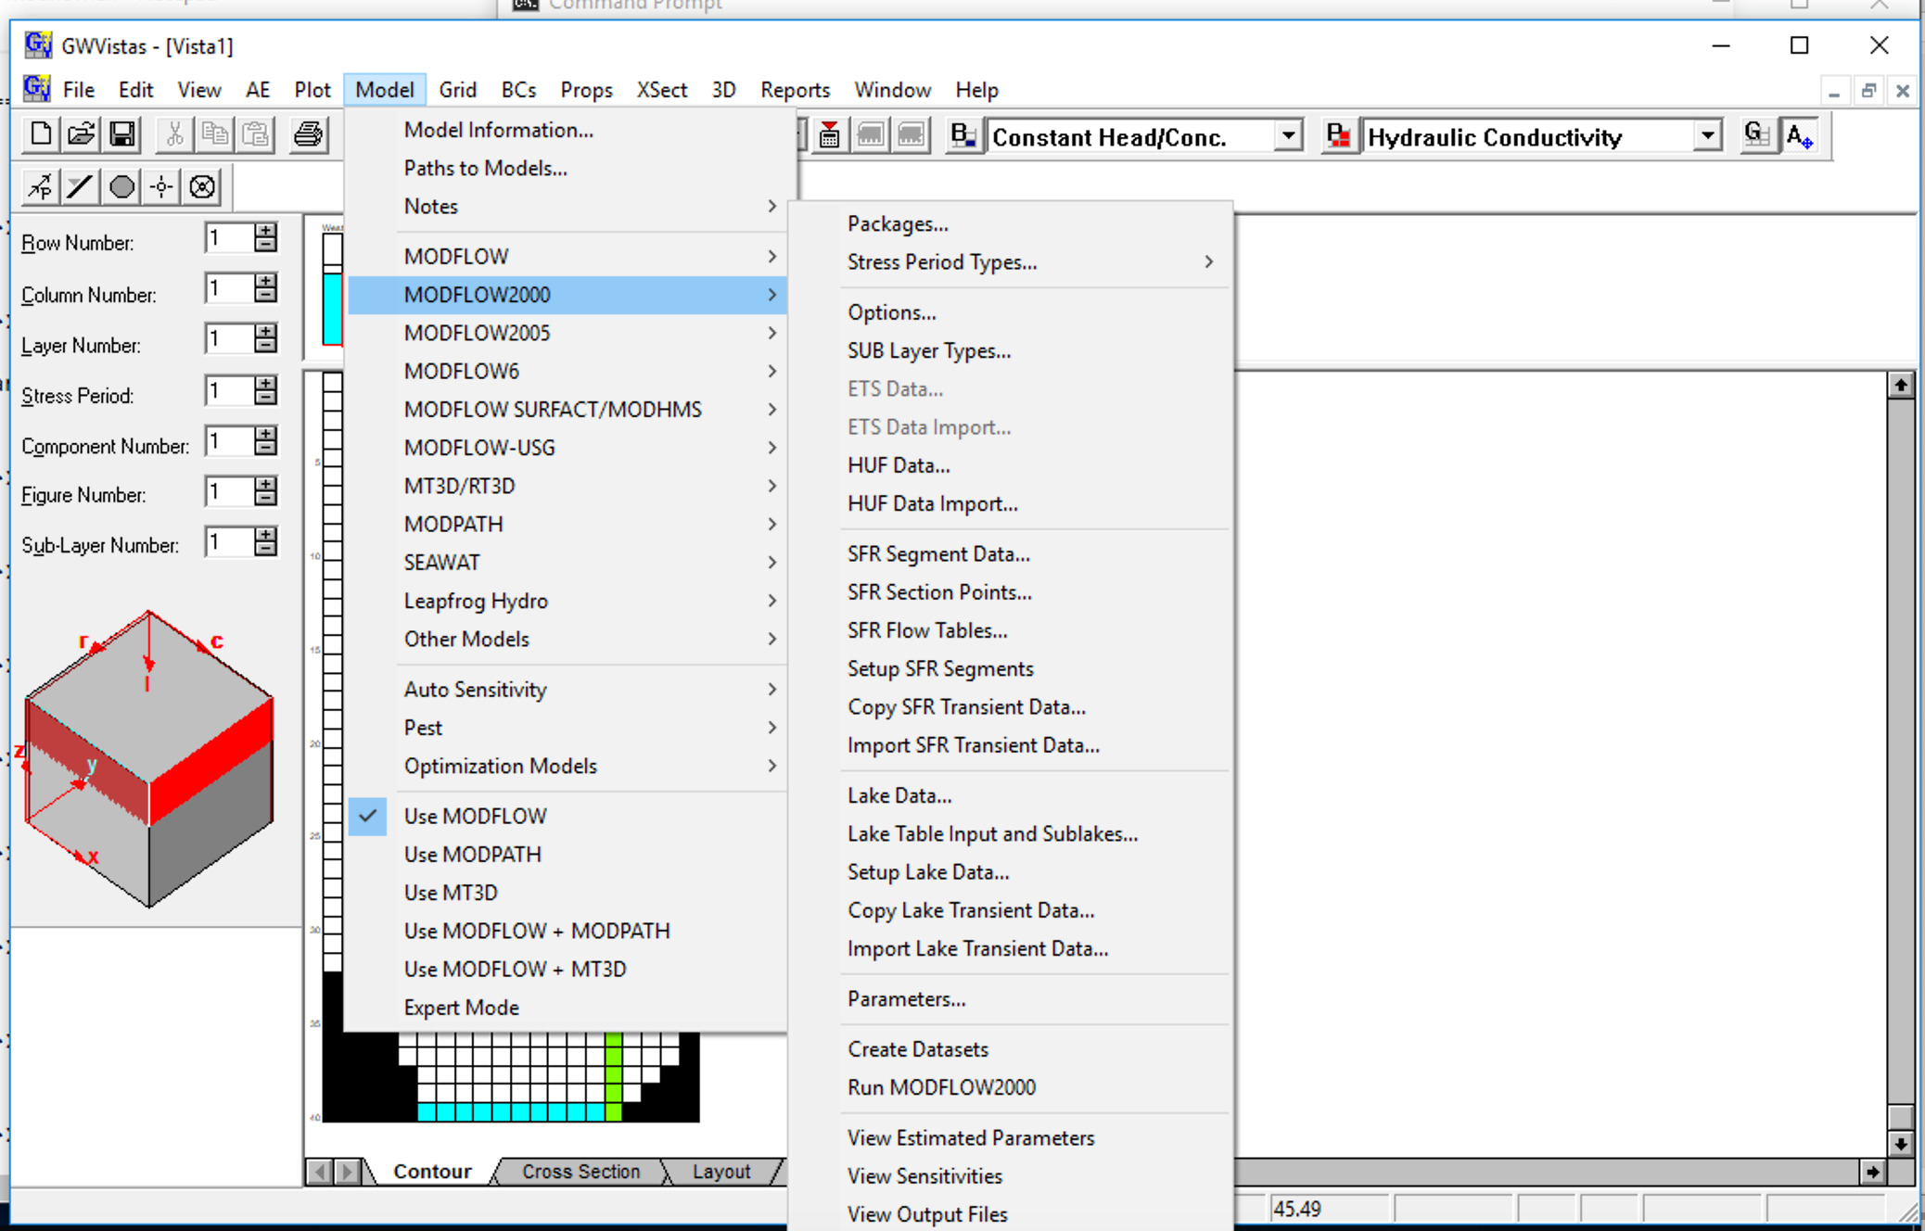
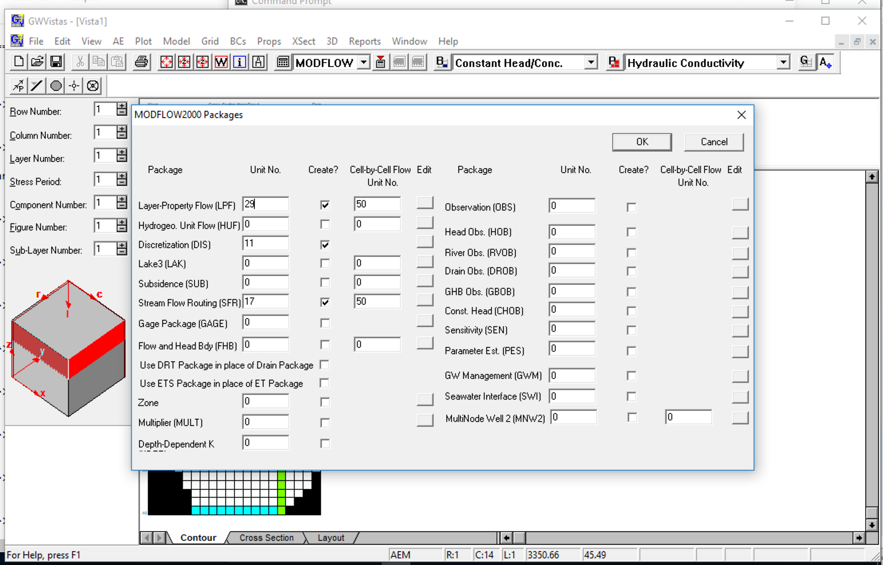

6) Reset conflicting MODFLOW Unit #31 (cont.) Look at *.nam file, Set to UPW to 29; re-create datasets and re-run MODFLOW ala Step #5

Slide 7
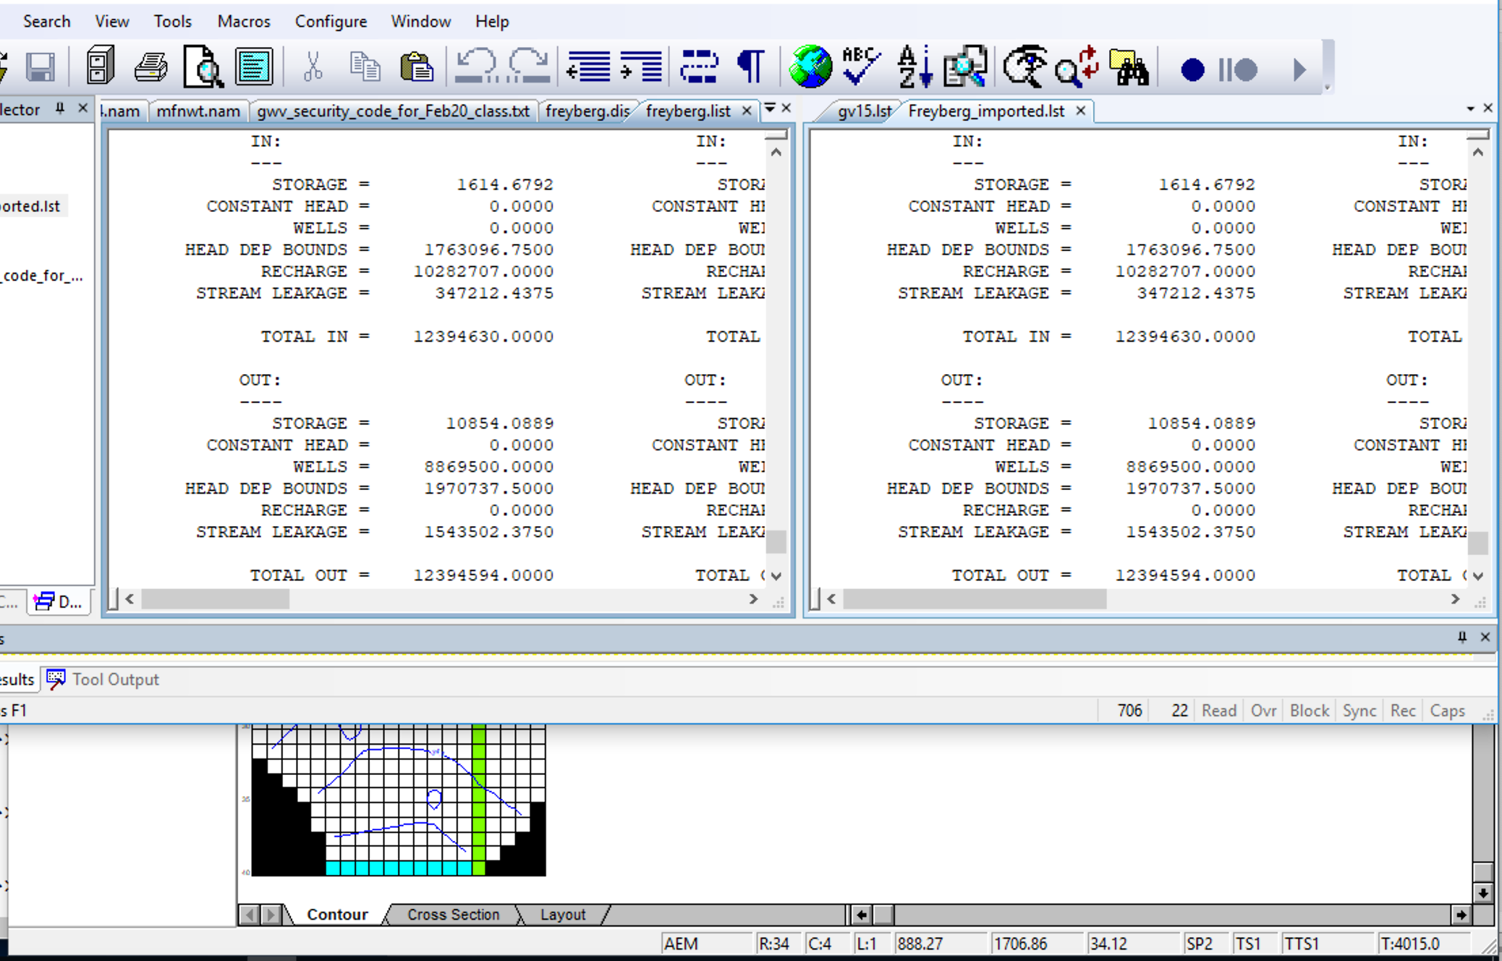
7) Check the import by comparing MODFLOW LIST file output (cumulative volumetric budget is most stringent) in a text editor
Original .list file from Flopy
New .lst file from GWV

Slide 8
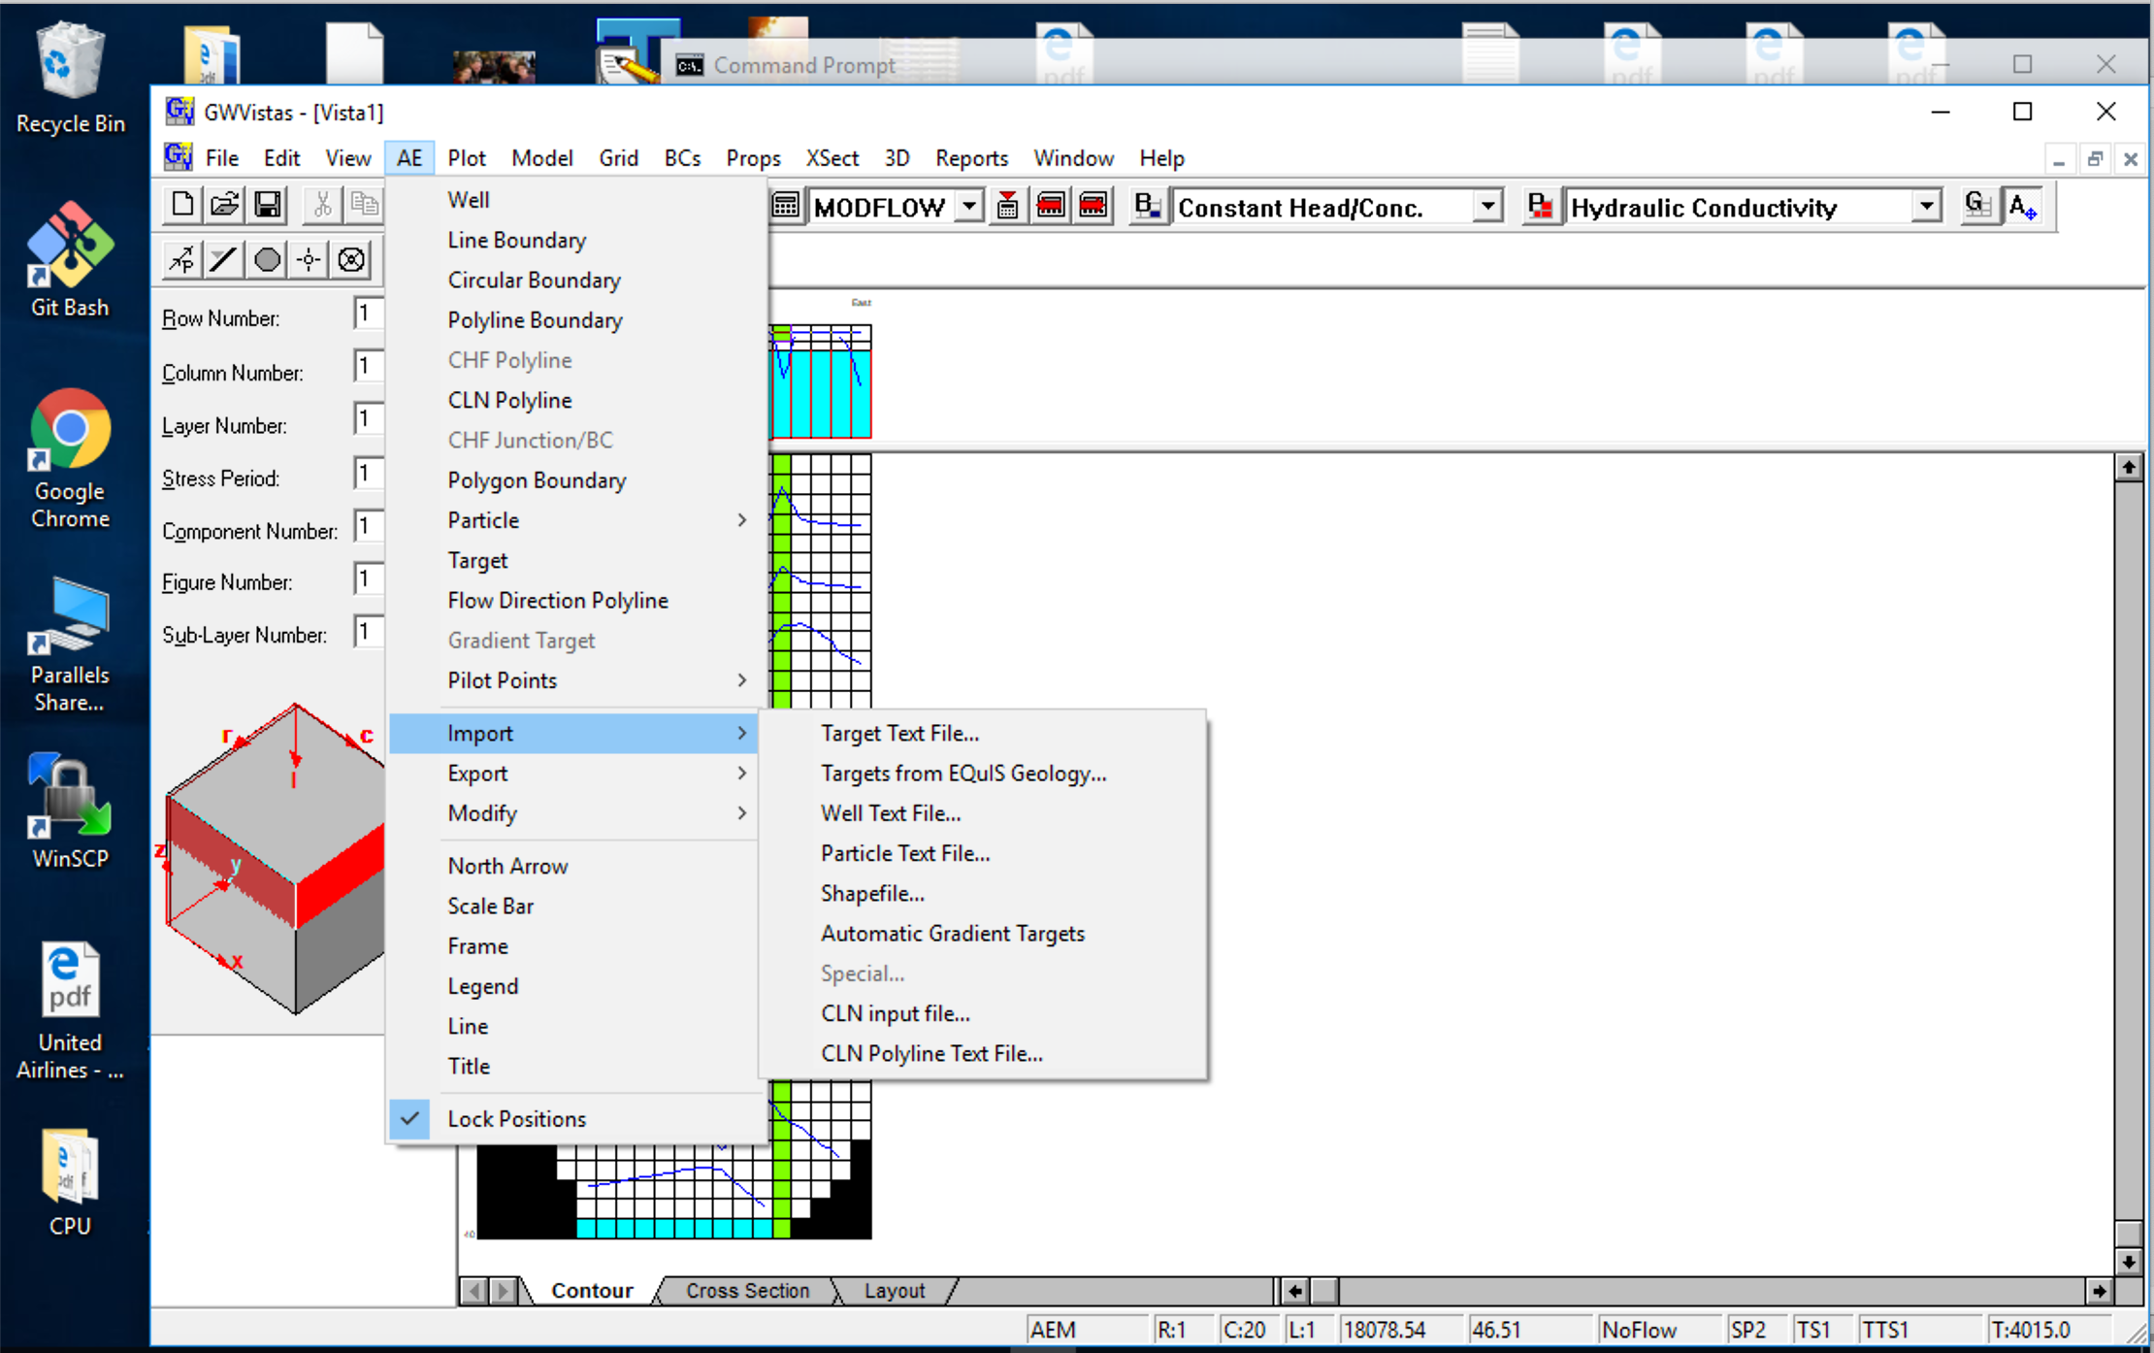
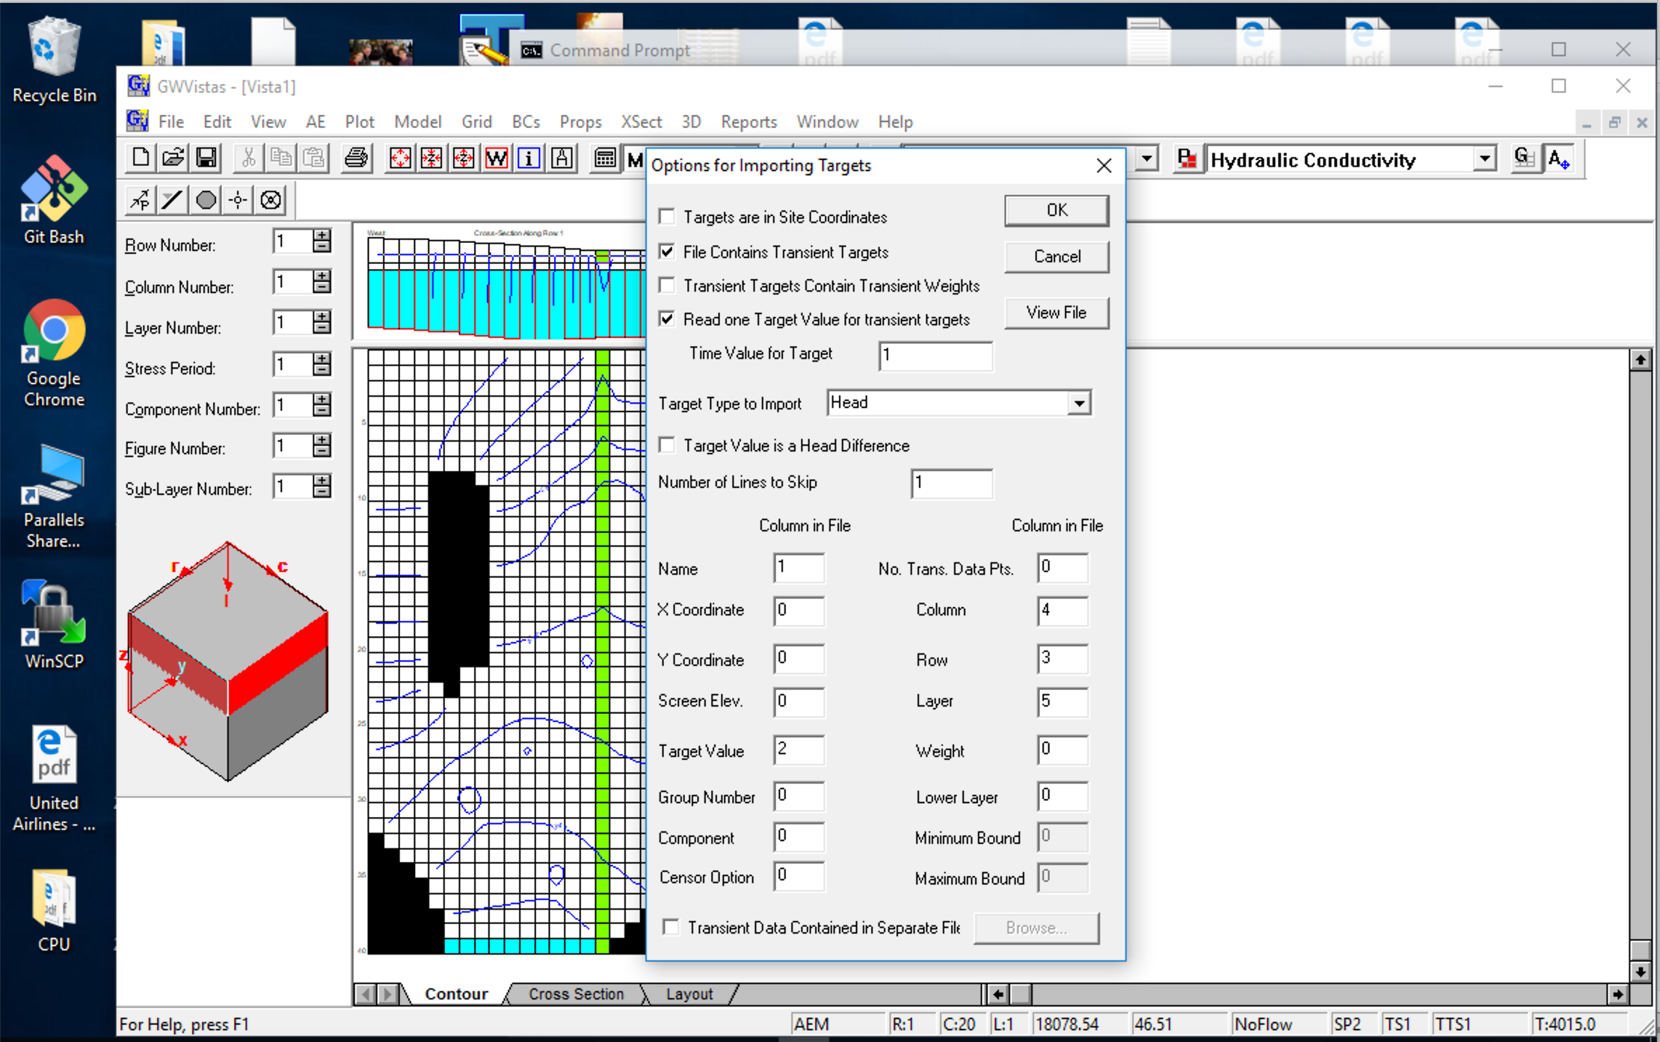
8) Import *.csv file of head obs
(use the settings in the dialogue box
They are not GWV defaults)

Slide 9
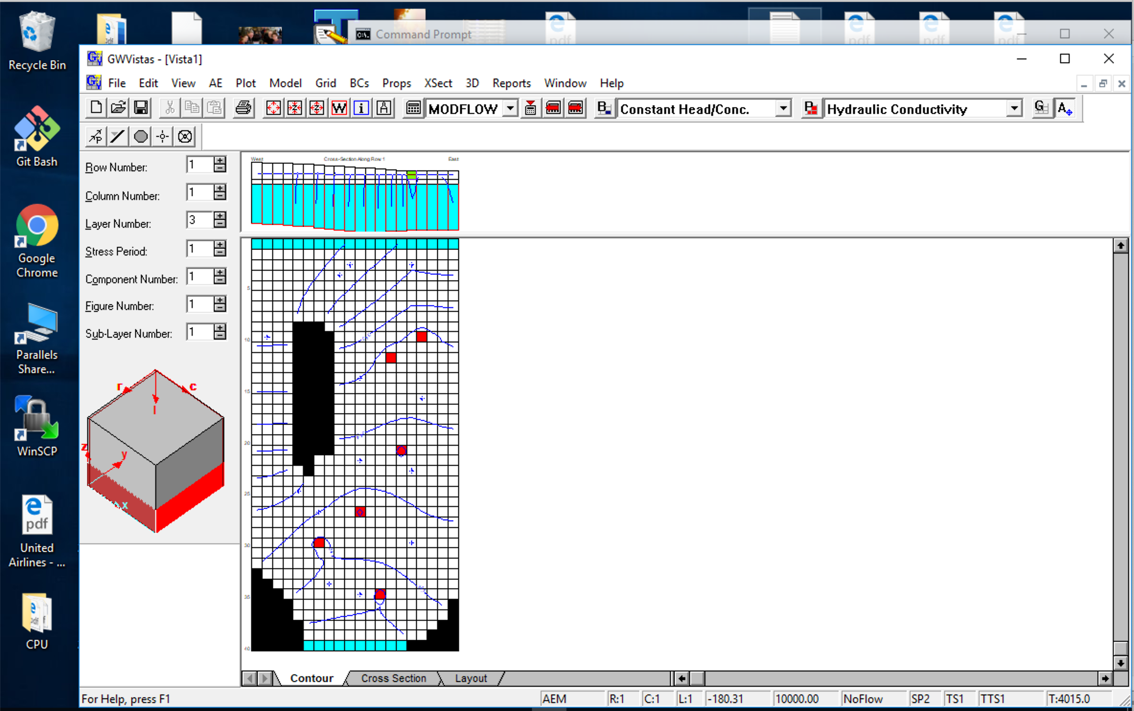
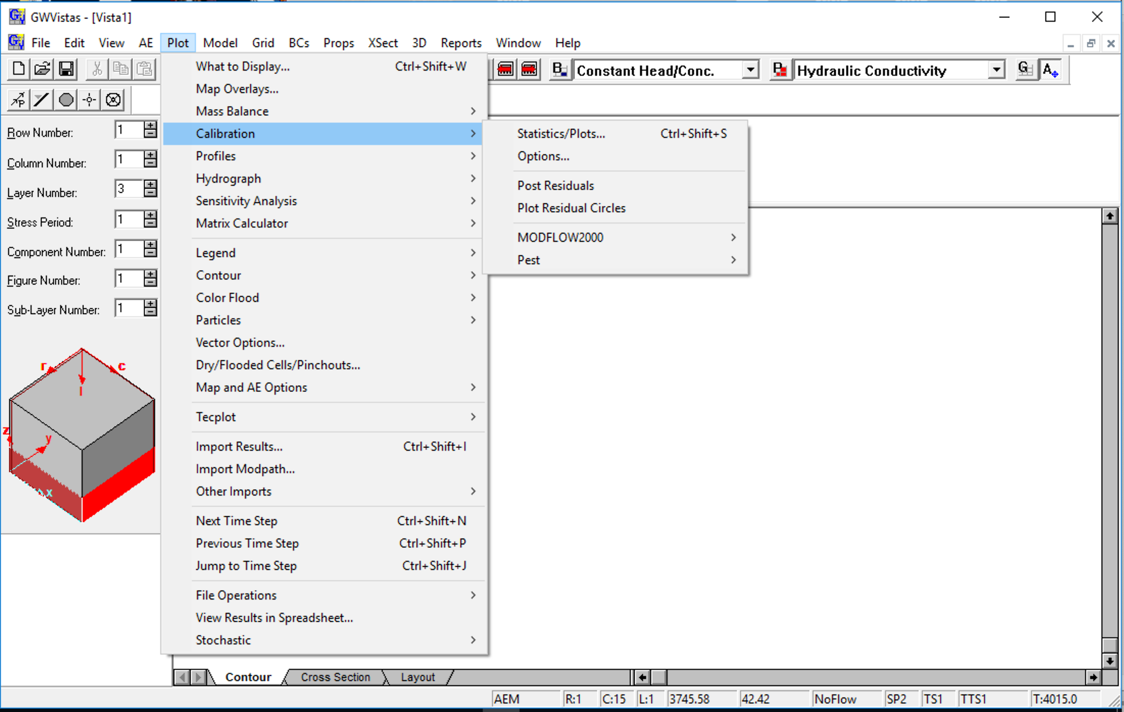
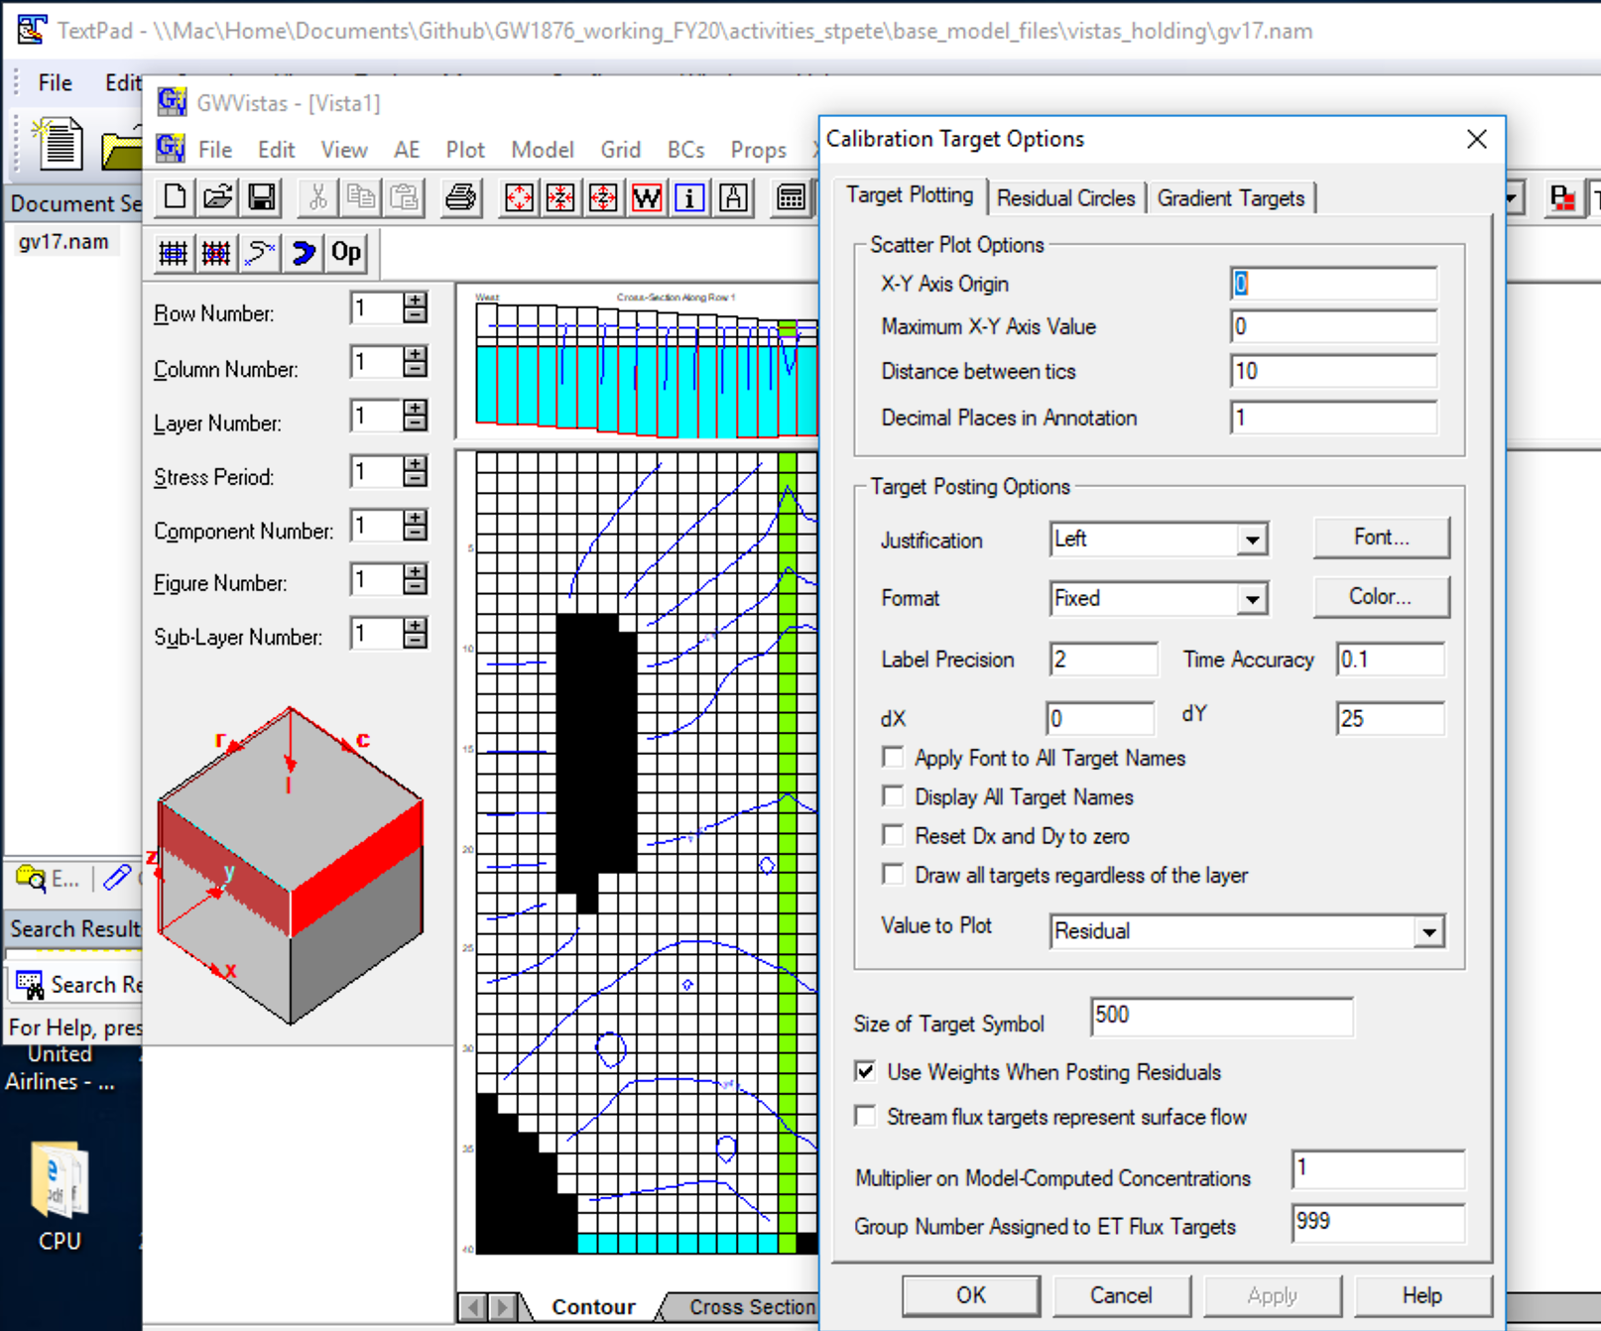
9) Make the head obs symbols bigger to see them, set to 500

Slide 10
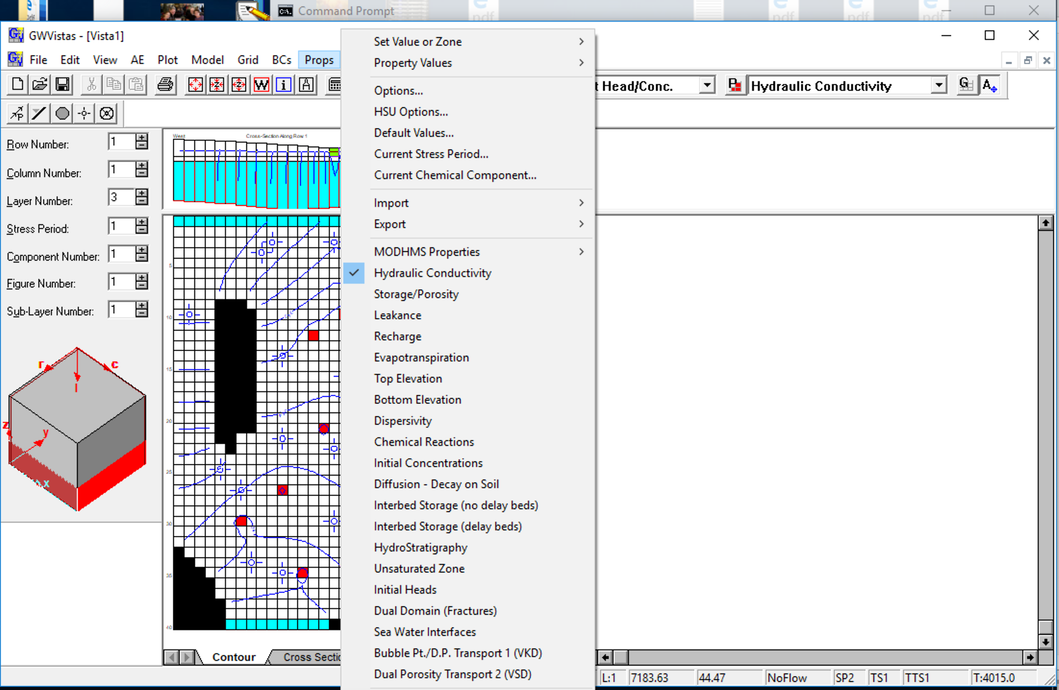
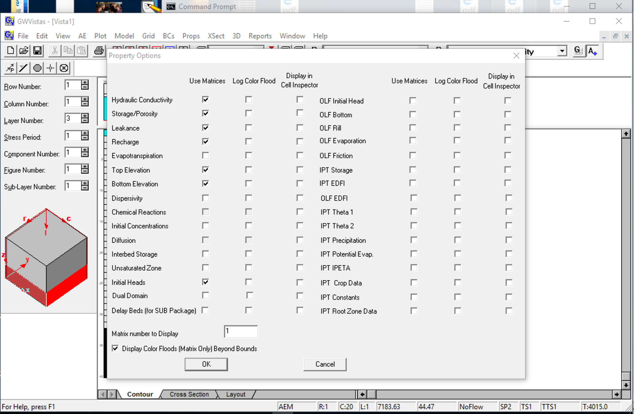
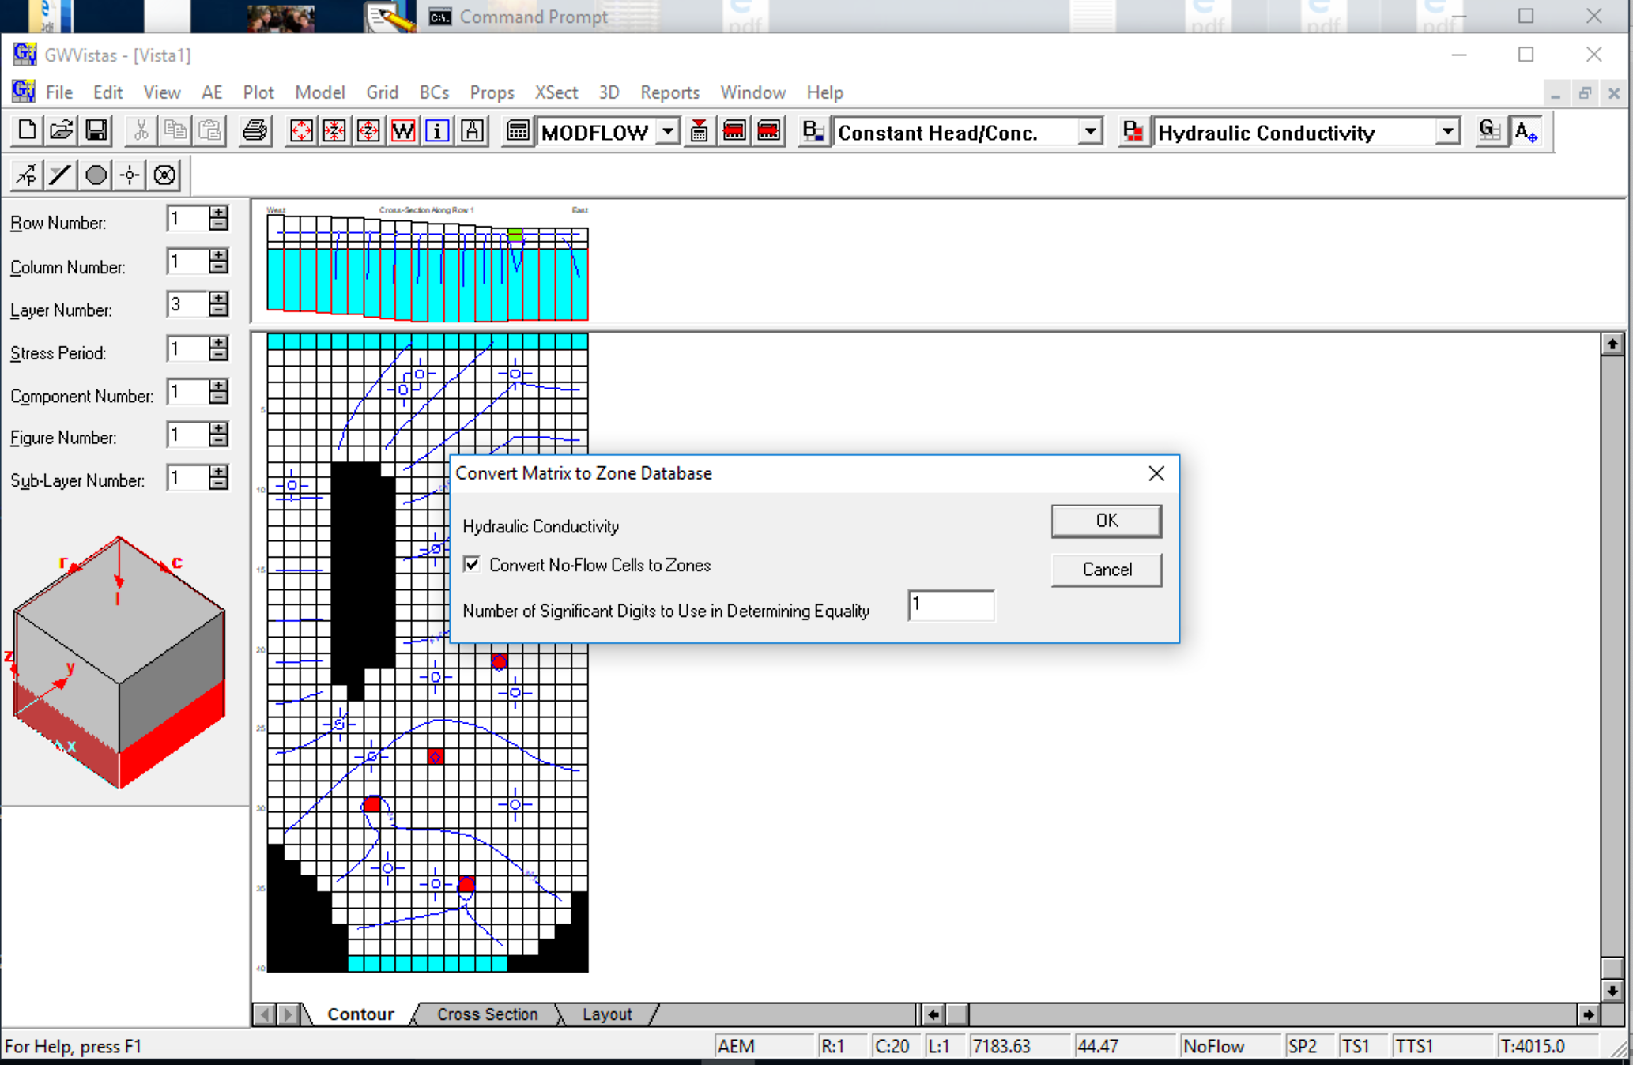
10) Turn the matrix of K into zones for overdetermined parameter estimation by unchecking “Use Matrices” and setting sig figs to 1

Slide 11
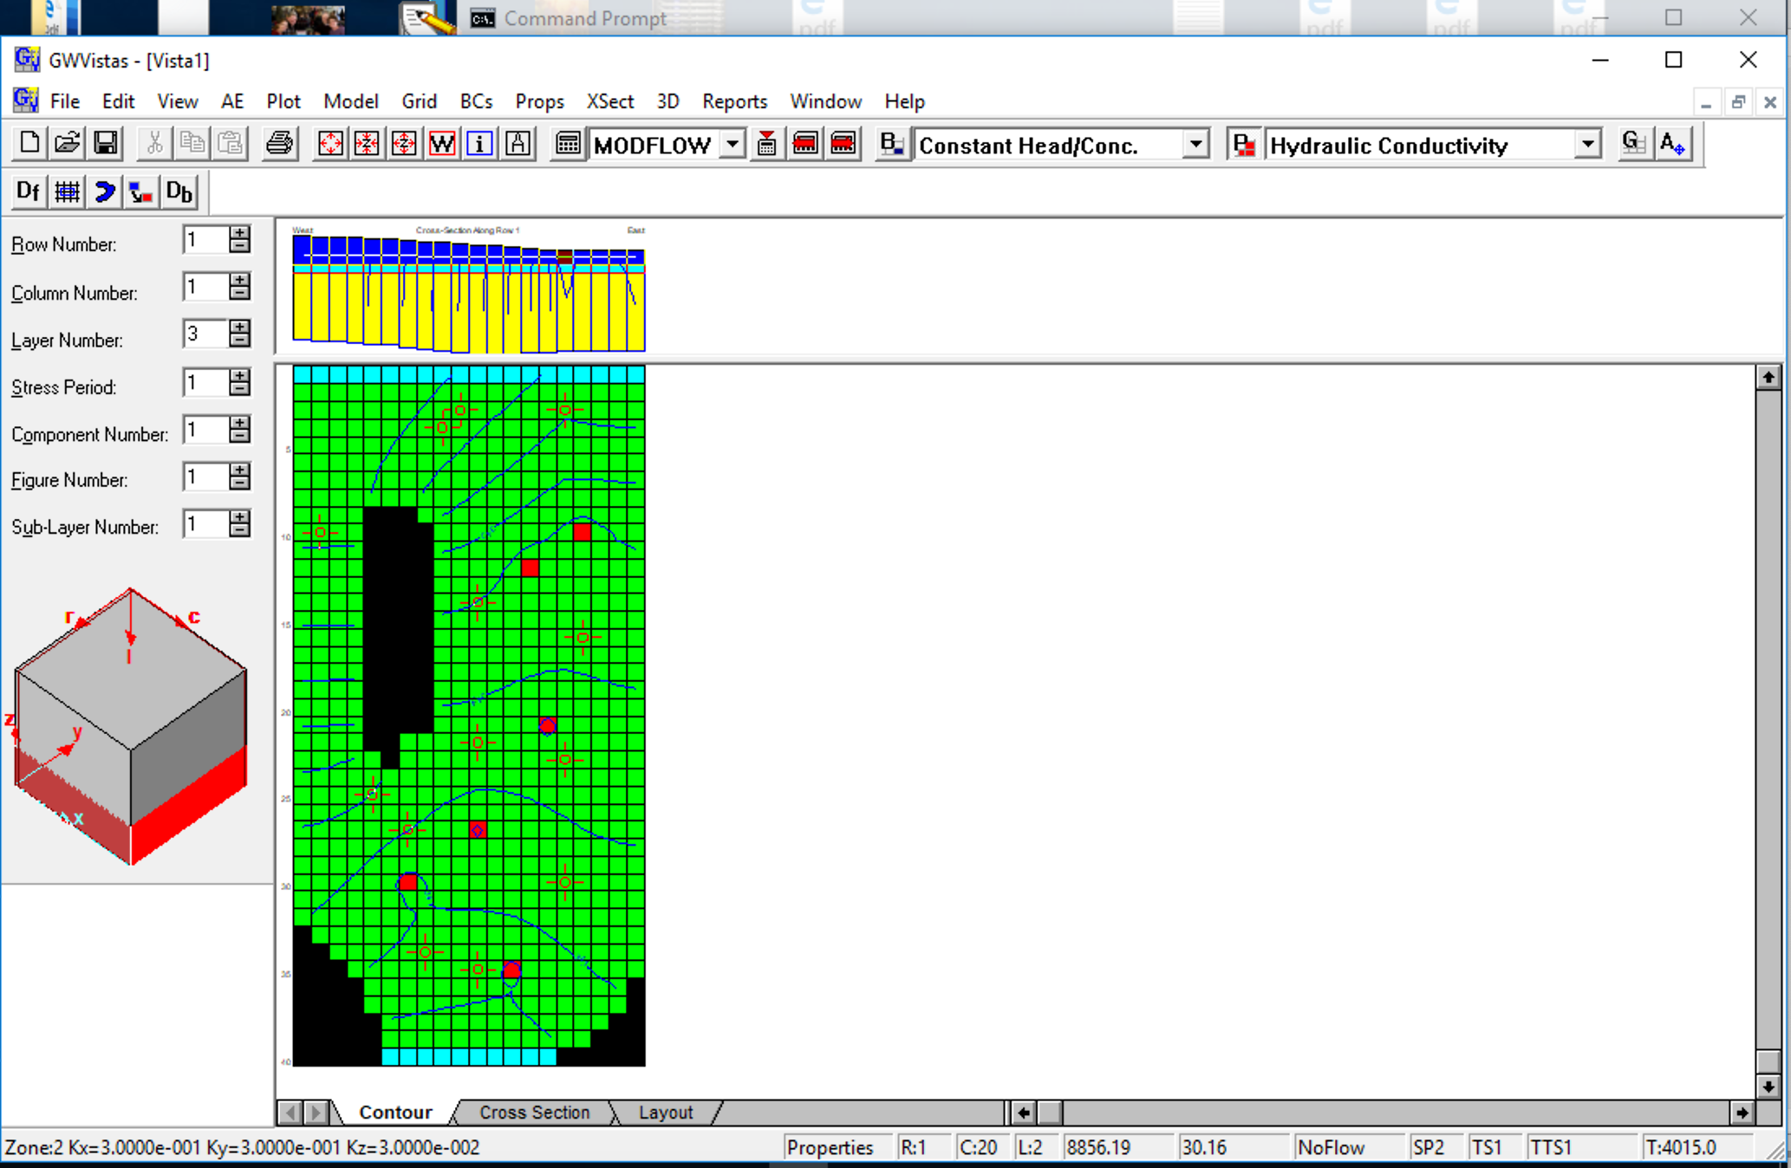
11) cont.
Note zones in lower left corner now

Slide 12
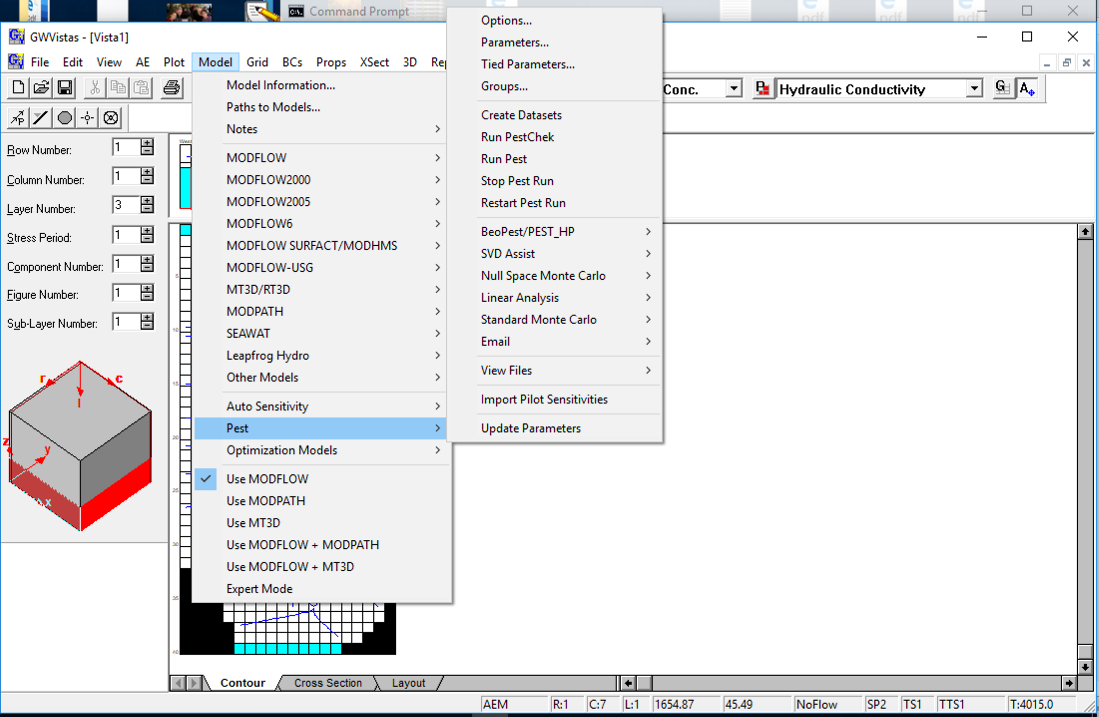
12) Make PEST files using GWV defaults – need to define parameters to adjust

Slide 13
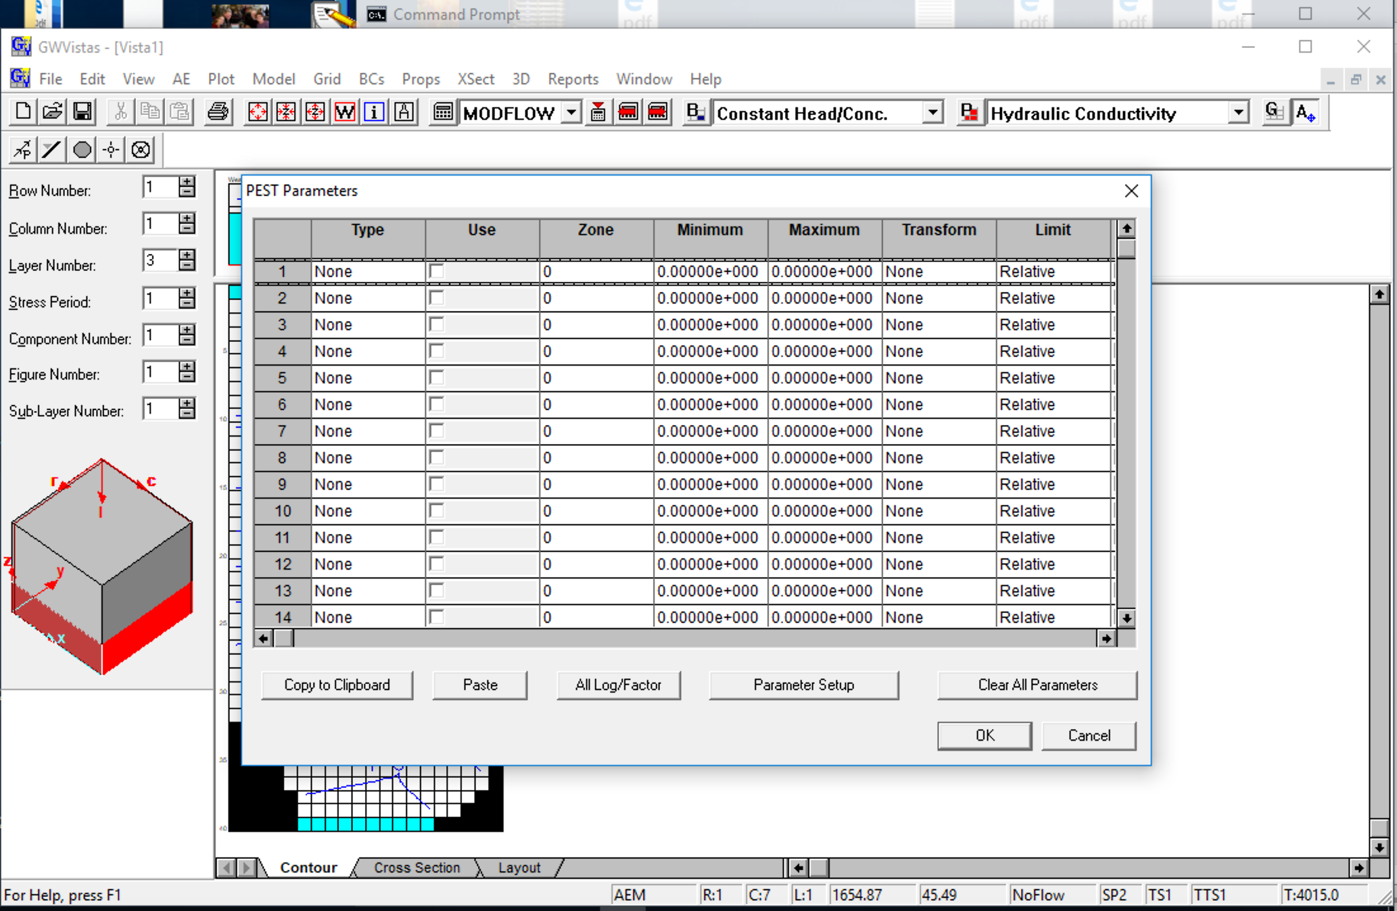
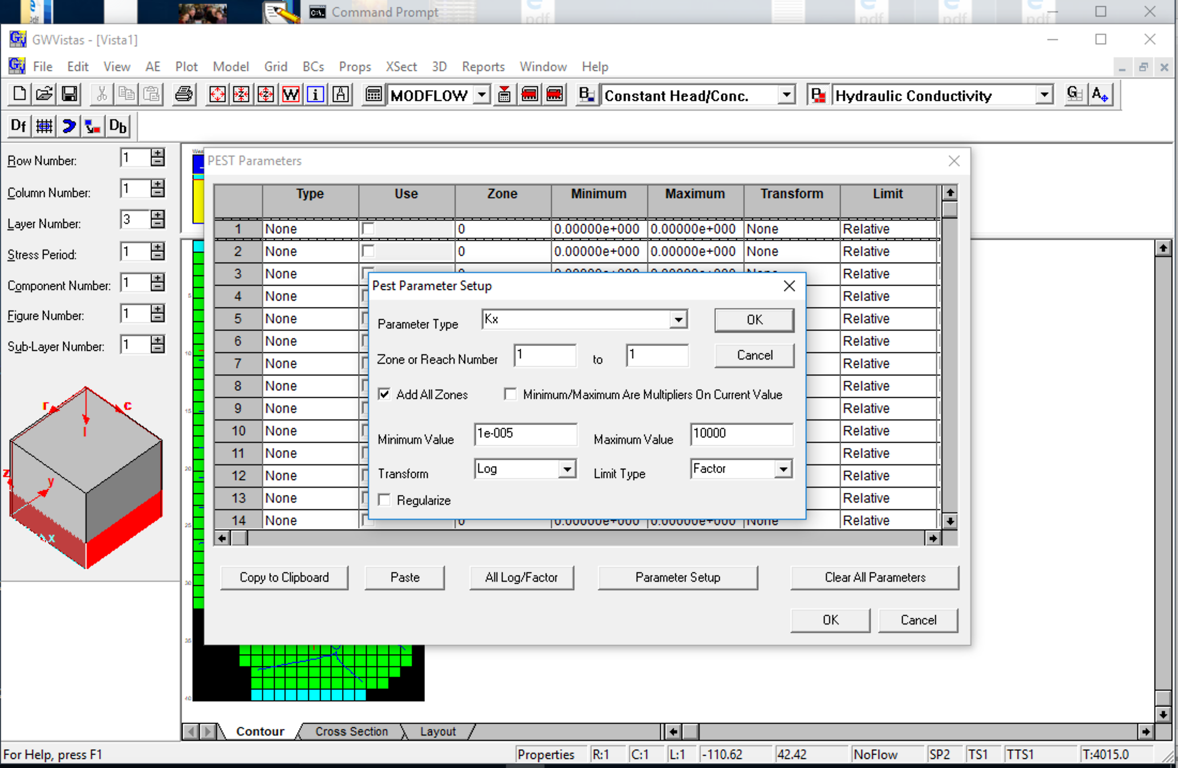
12) Make PEST files using GWV defaults – need to define parameters to adjust

Slide 14
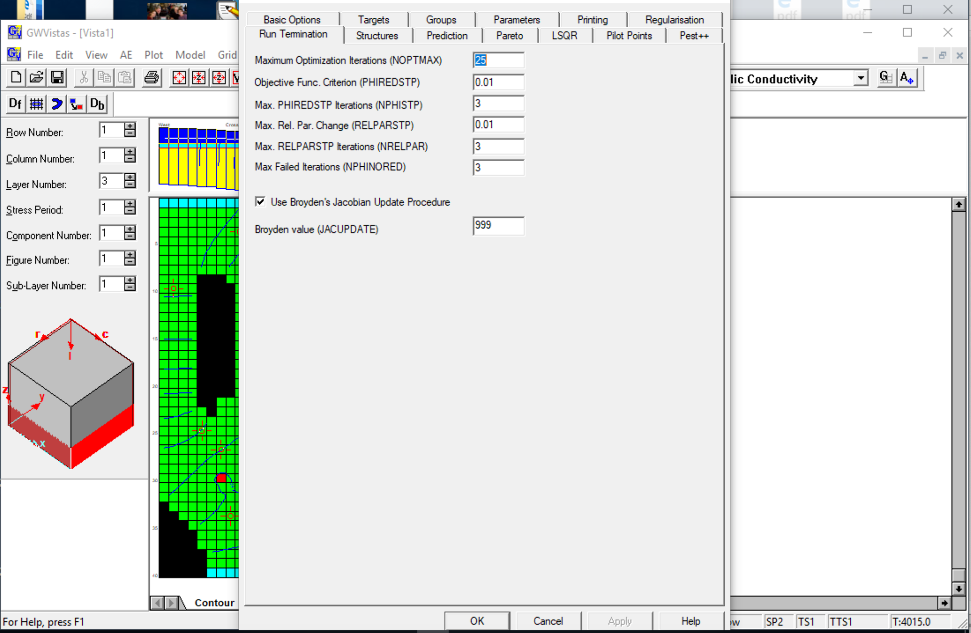
13) Change NOPTMAX to 0 to do just one run to check the plumbing
(Model->PEST->Options->Run Termination)
14) Create PEST files

Slide 15
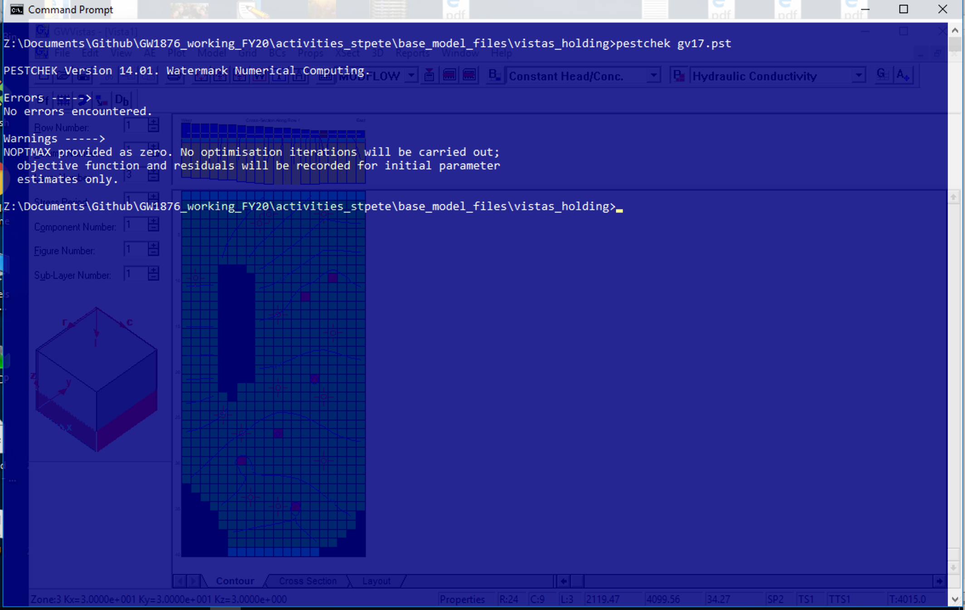
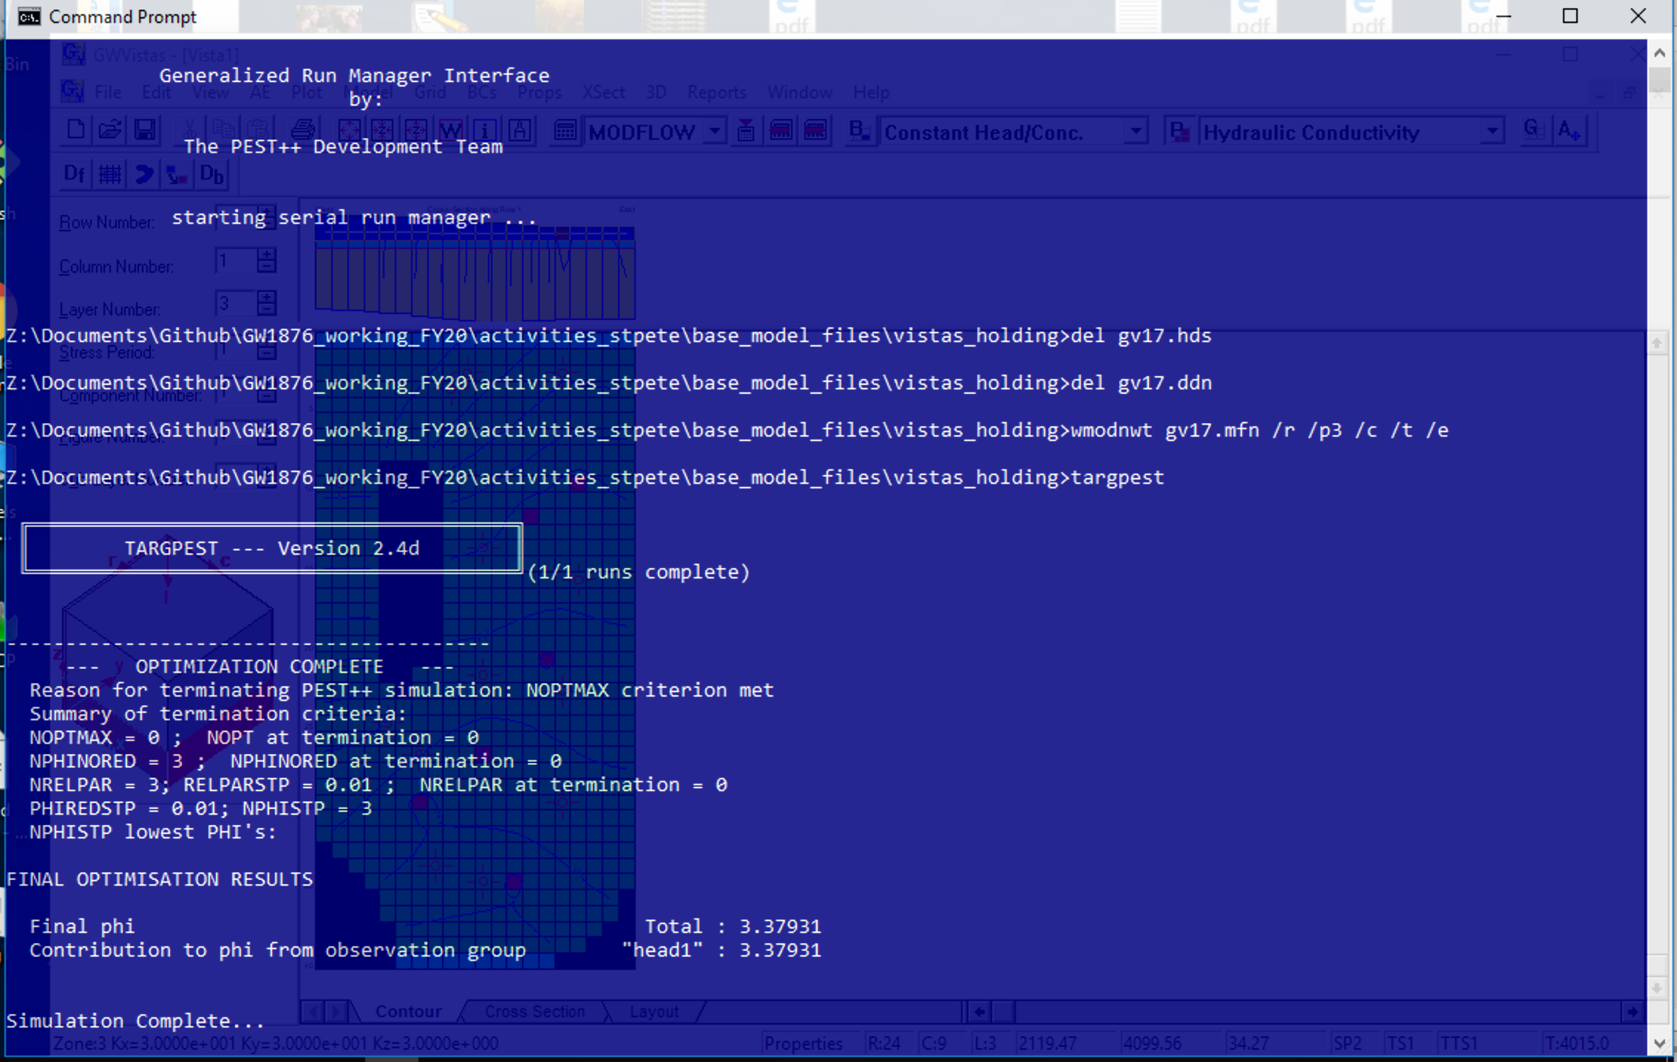
15) Run PESTCHEK.exe on newly created *.pst file in DOS prompt
16) Run pestpp.exe with *.pst file; the “phi” is circled and reflects the sum squared weighted residuals misfit at initial values.

Slide 16
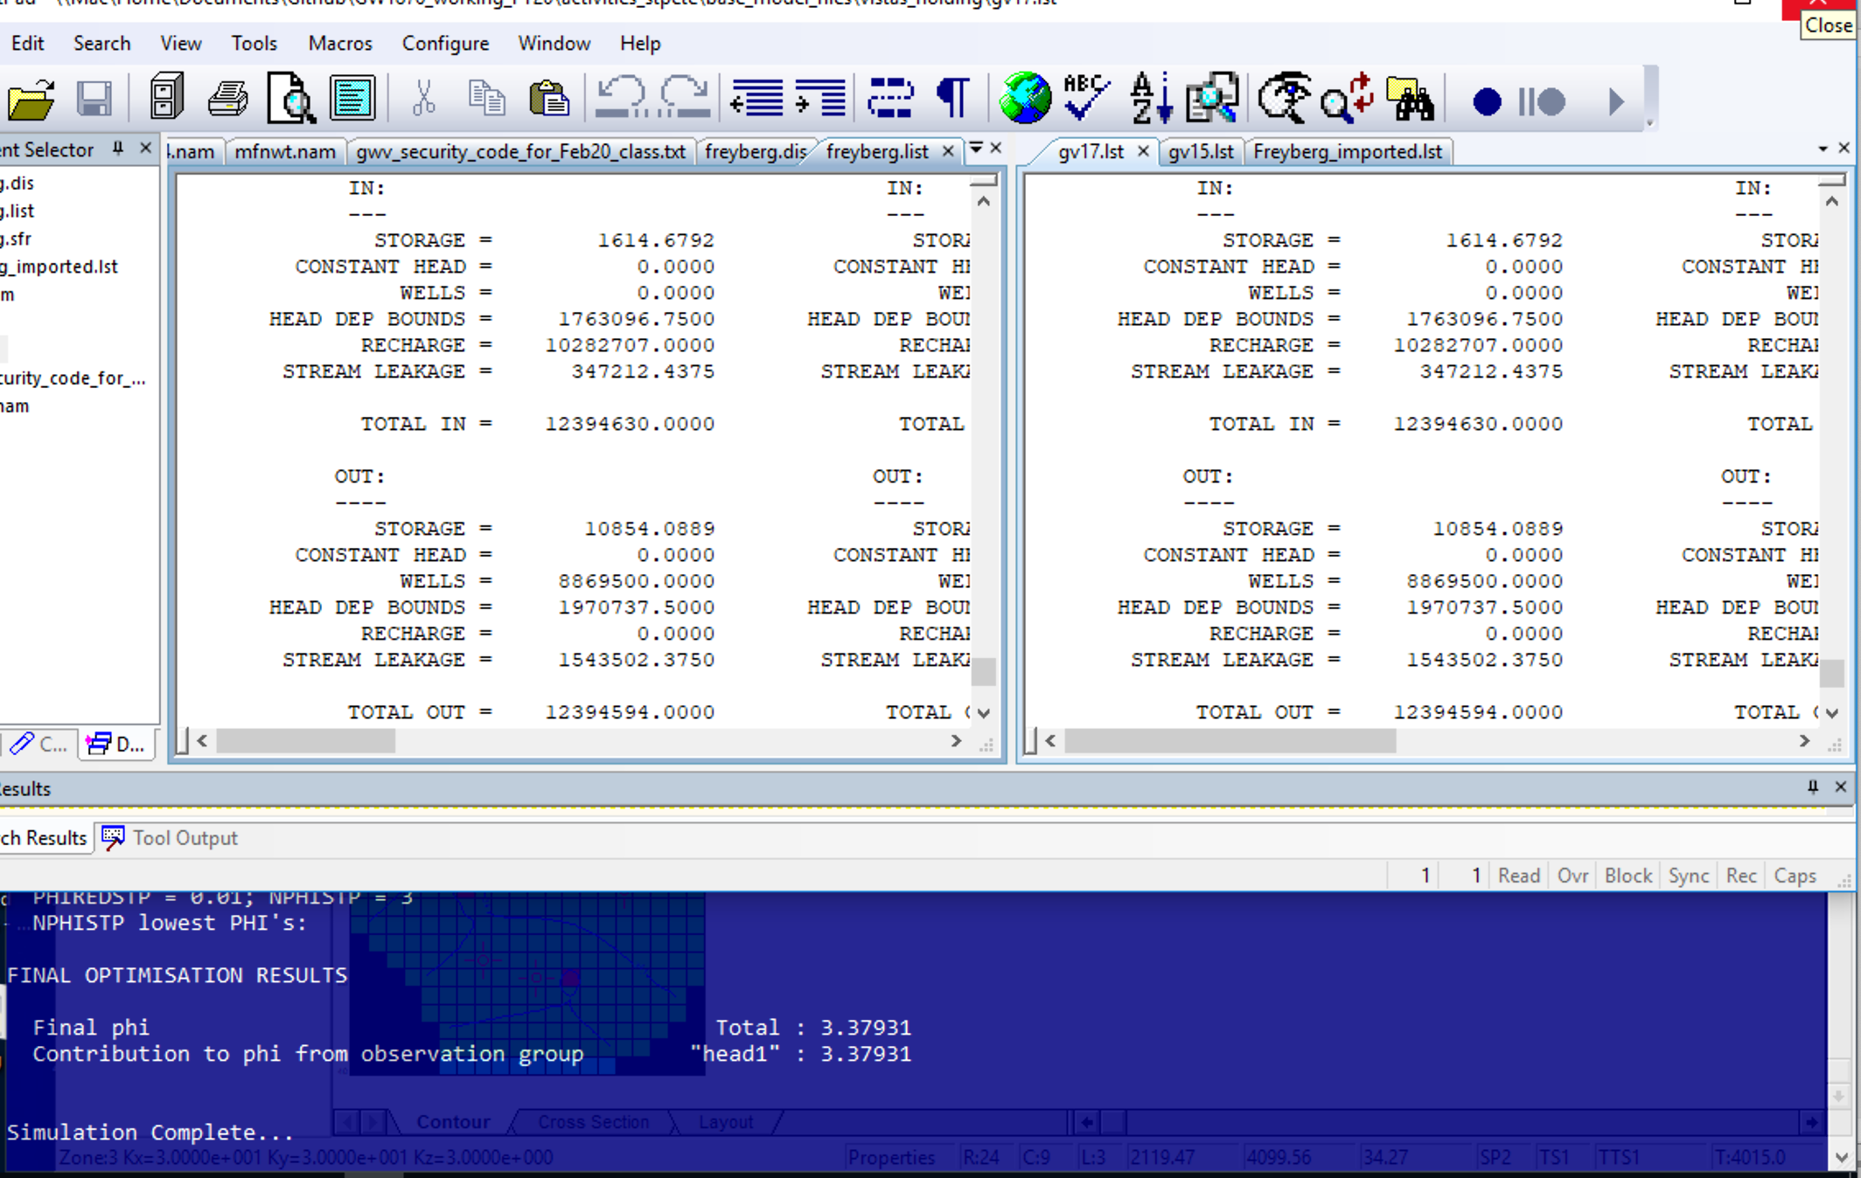
17) Check the PEST setup and plumging by comparing the original MODFLOW LIST file output to the new MODFLOW list file from the PESTPP run
Original .list file from Flopy
New .lst file from PEST run

Slide 17
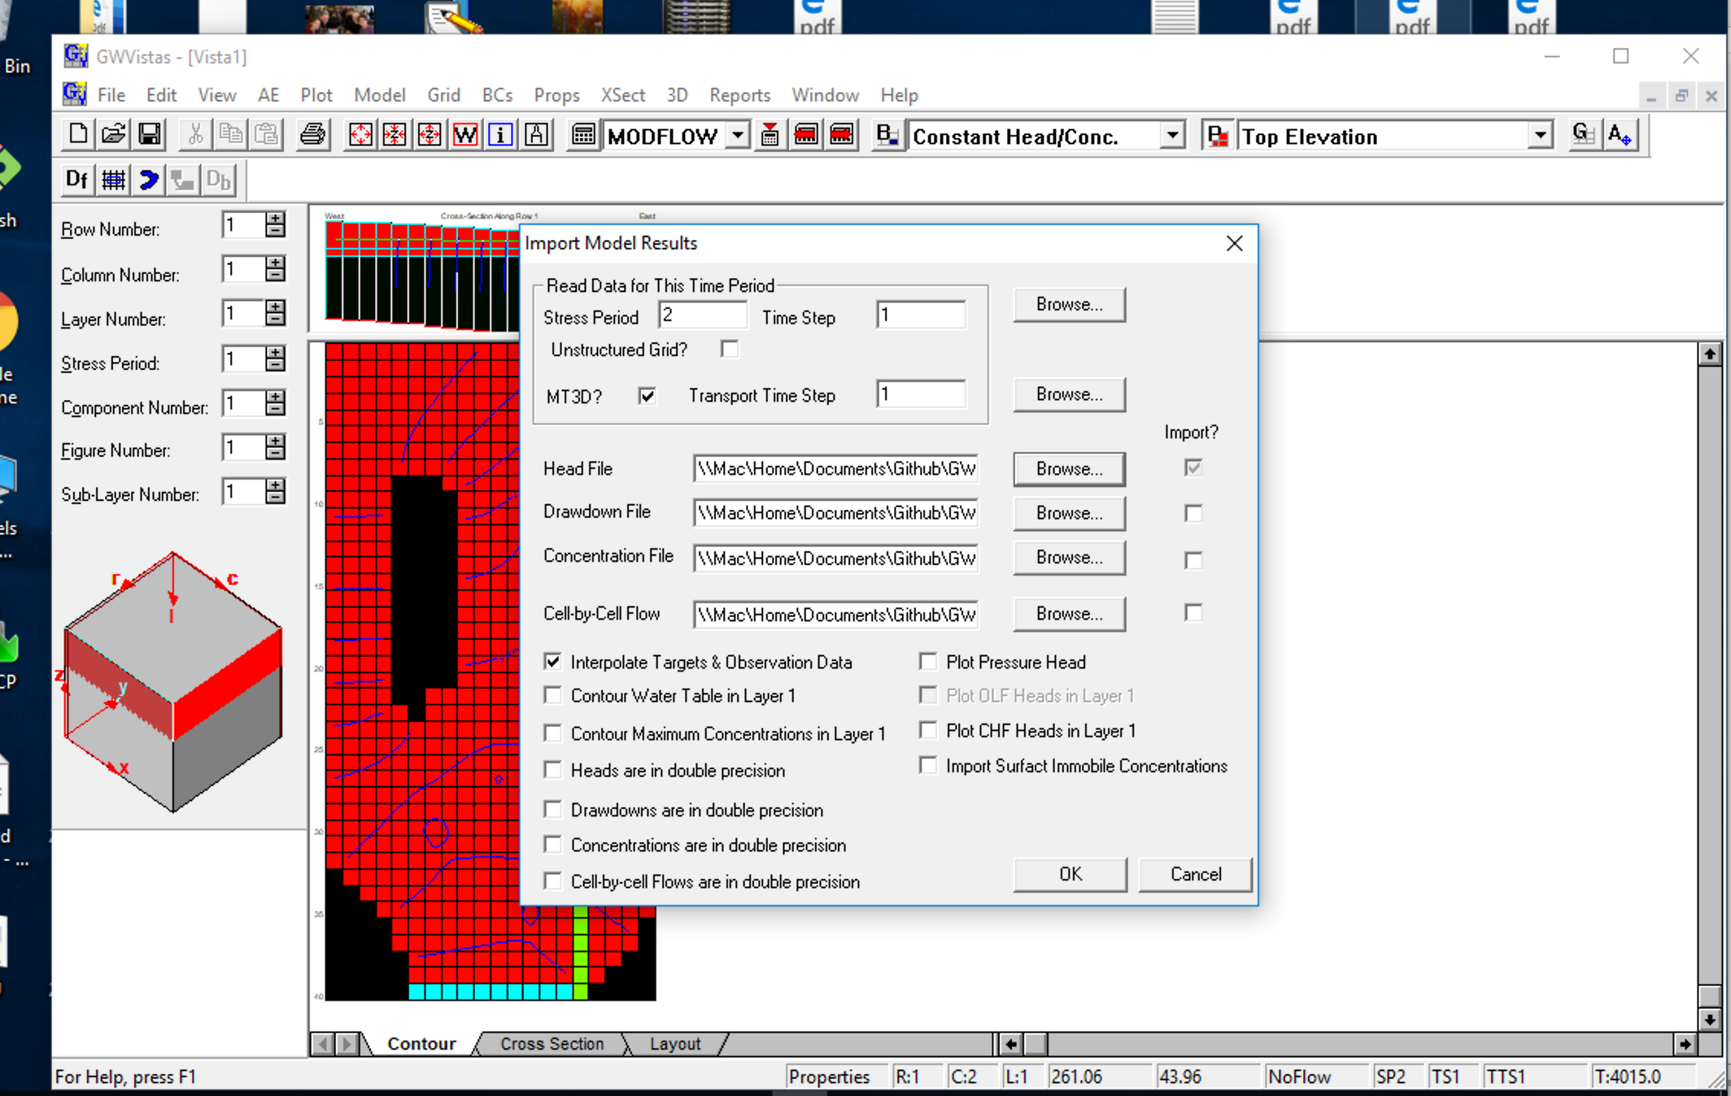
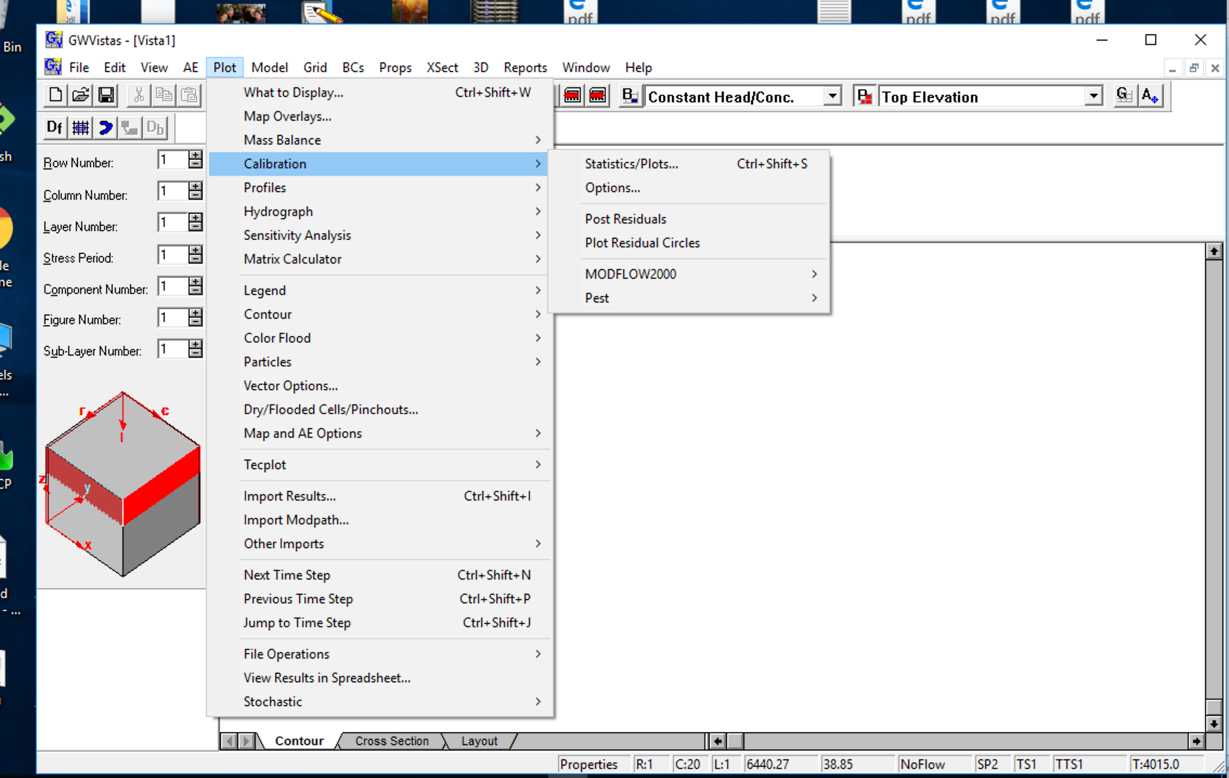
18) Check head calibration by importing model results back into GUI (plot->Import model results)
Browse to working directory if not already there, import most recent *.hds file
18) Look at calibration statistics and graphs (plot->calibration-> Statistics/Plots)

Slide 18
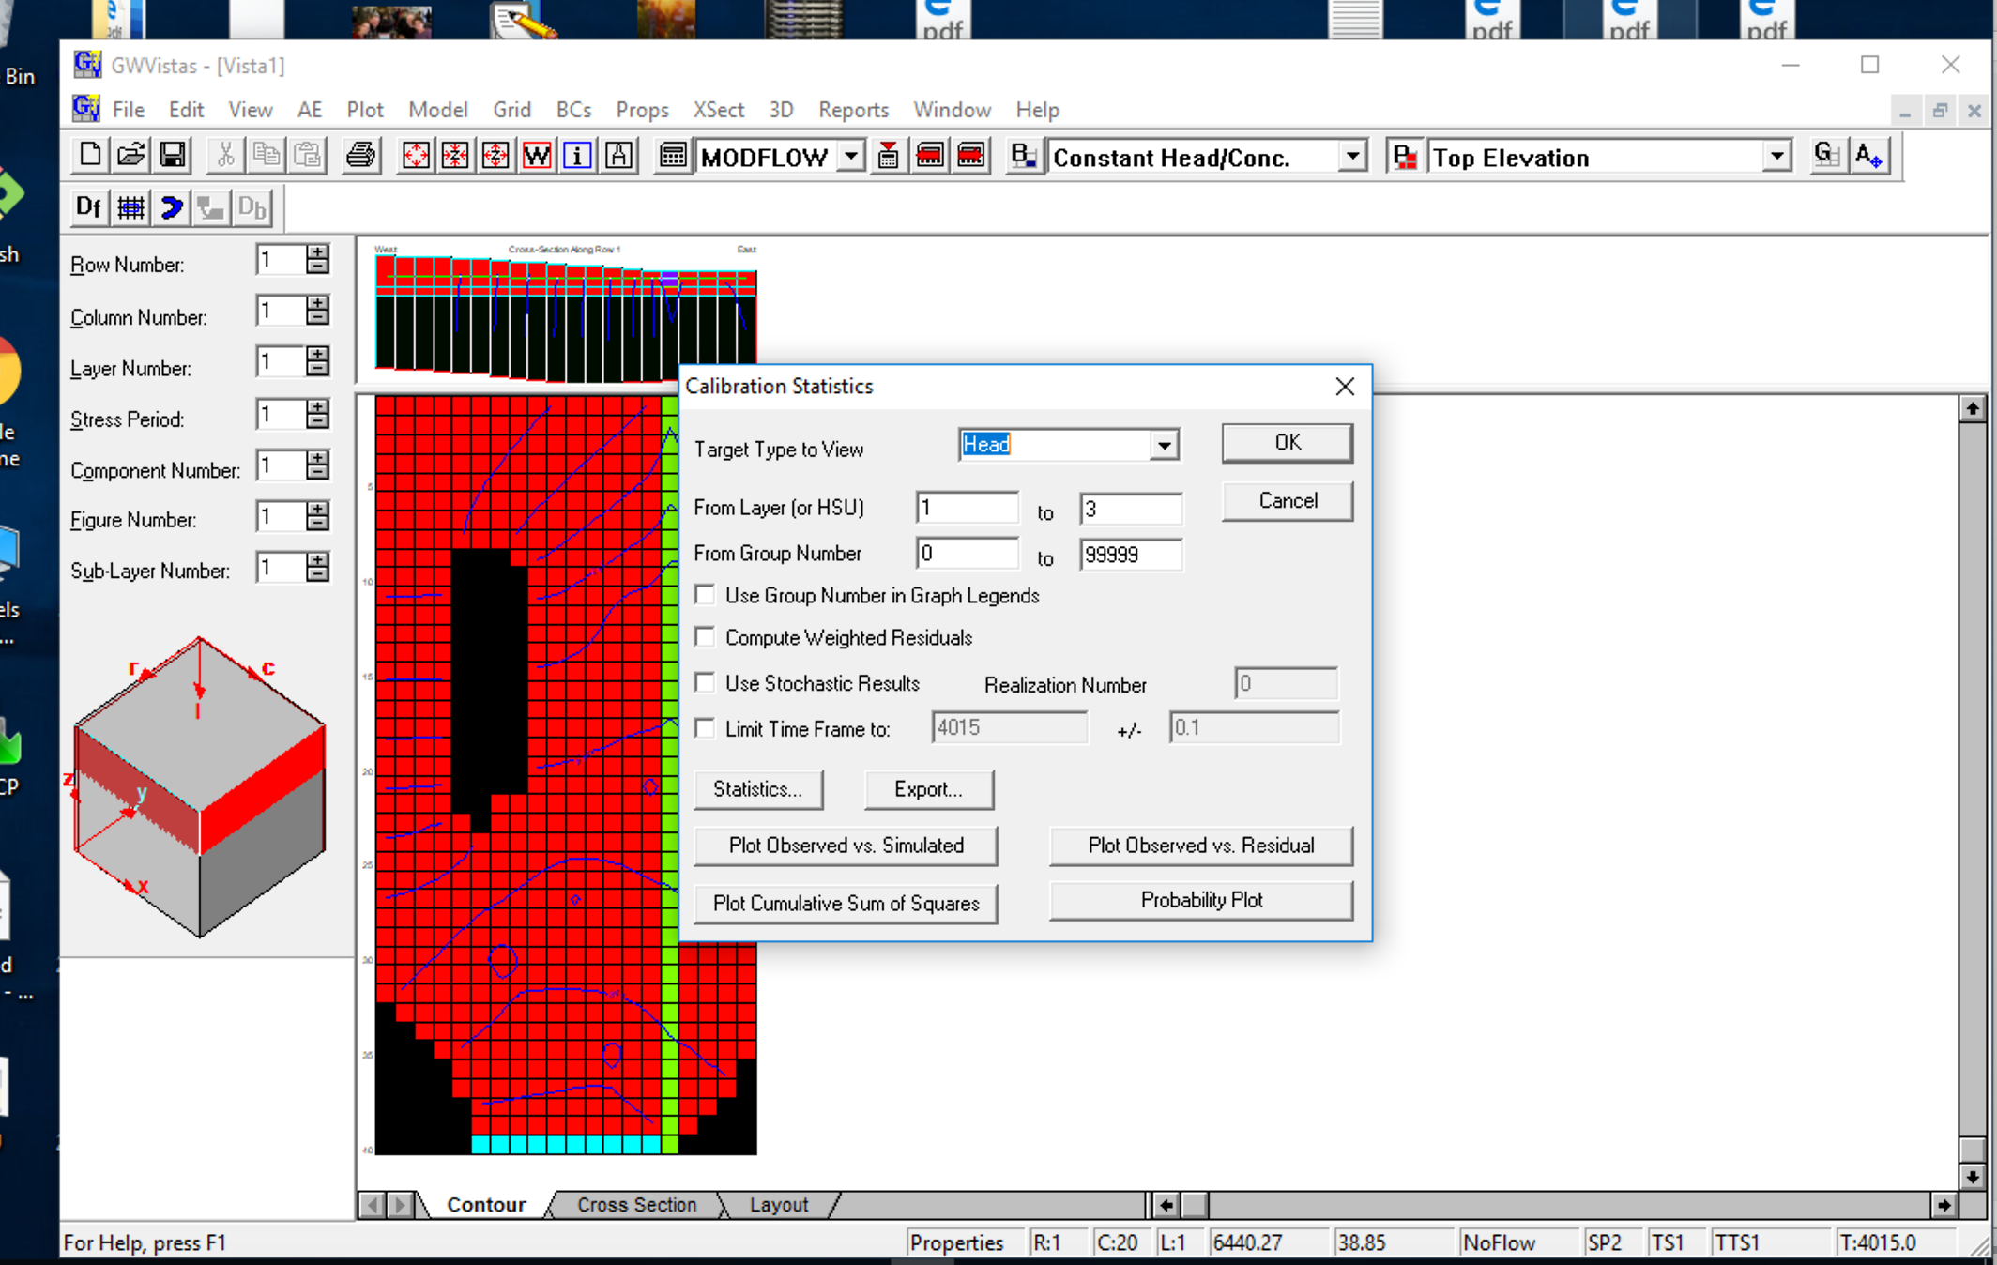
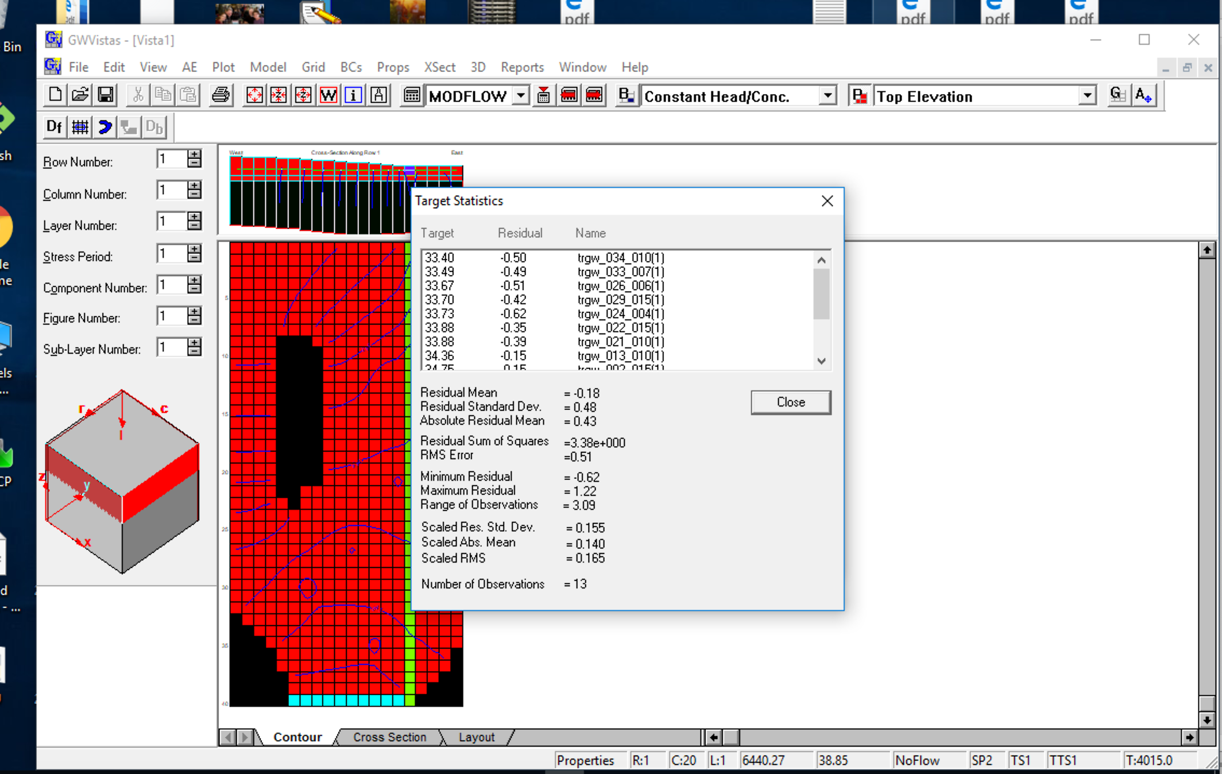

Slide 19
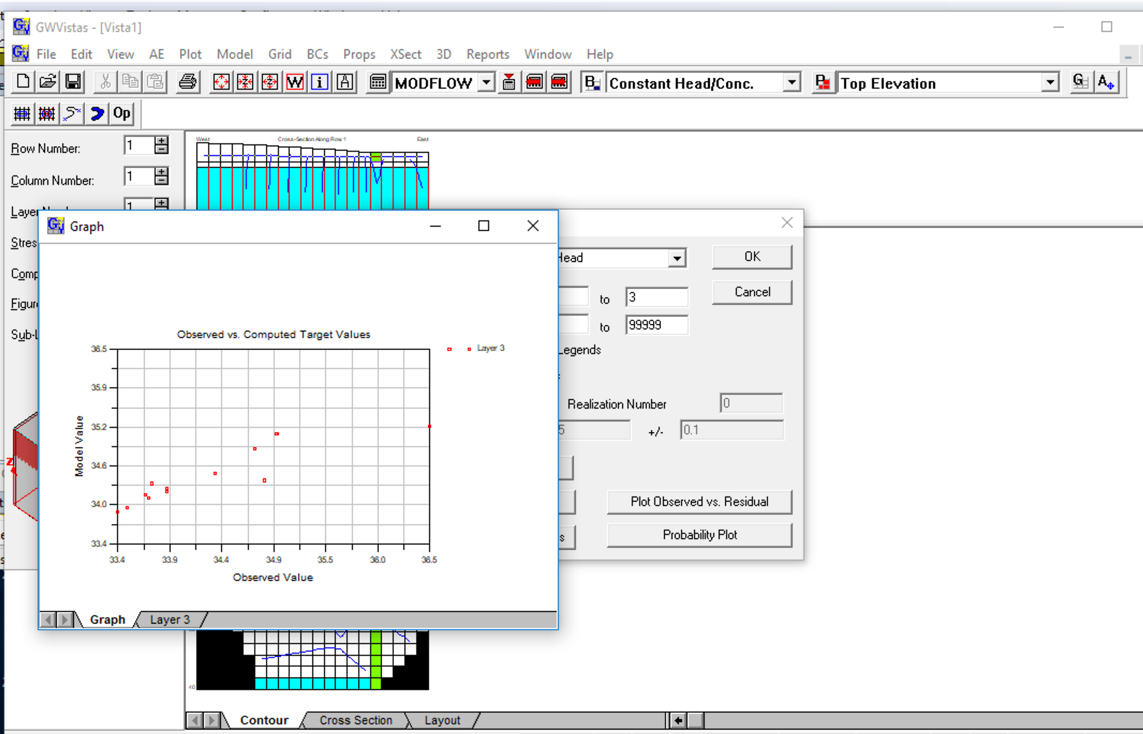

Slide 20
Like Step 13) Change NOPTMAX to 25 to do a parameter estimation run,
(Model->PEST->Options->Run Termination)
redo PESTCHEK.exe, and run pestpp
How much lower was phi? How much better were the unweighted calibration statistics?

Slide 21
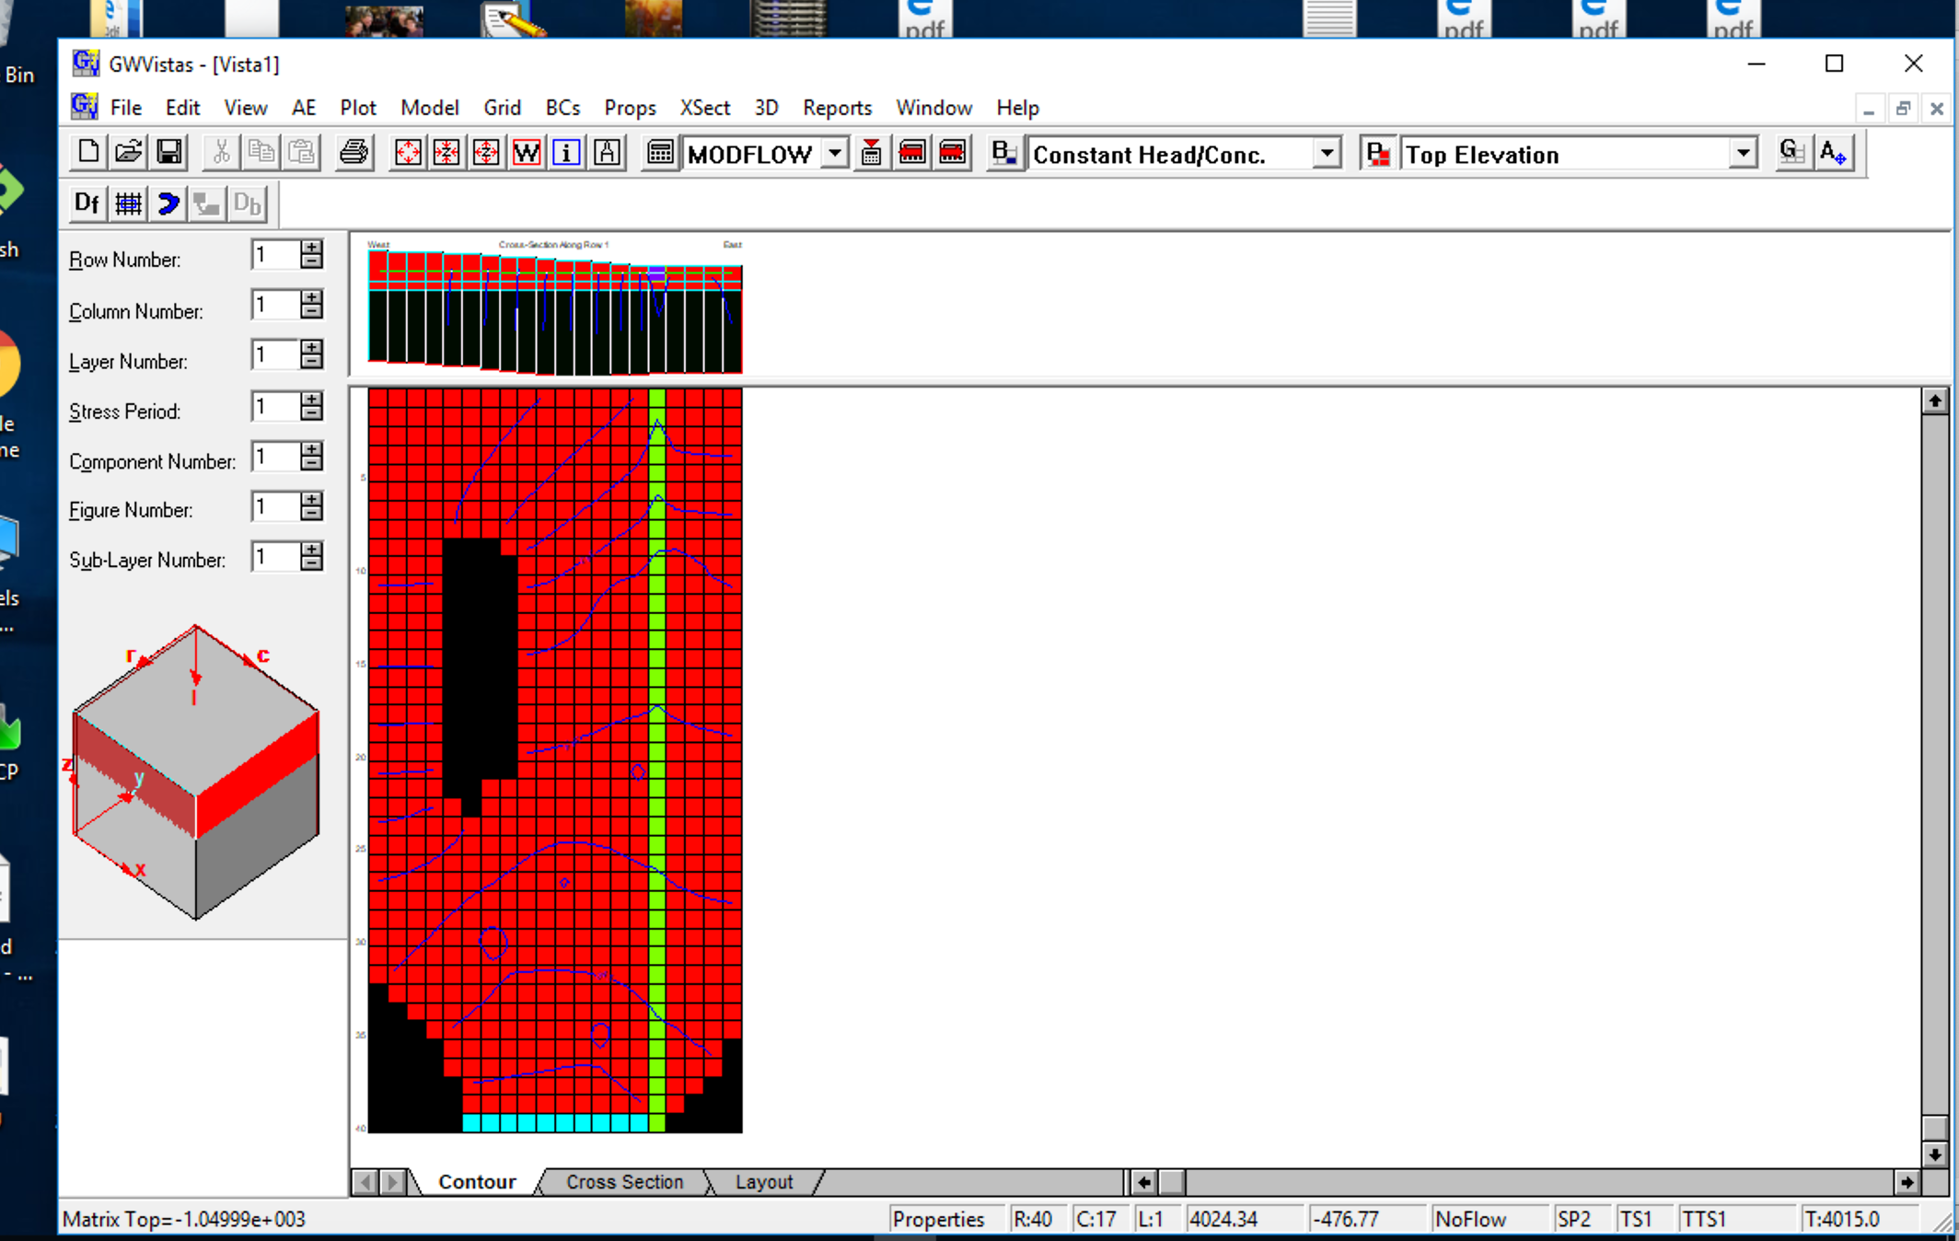
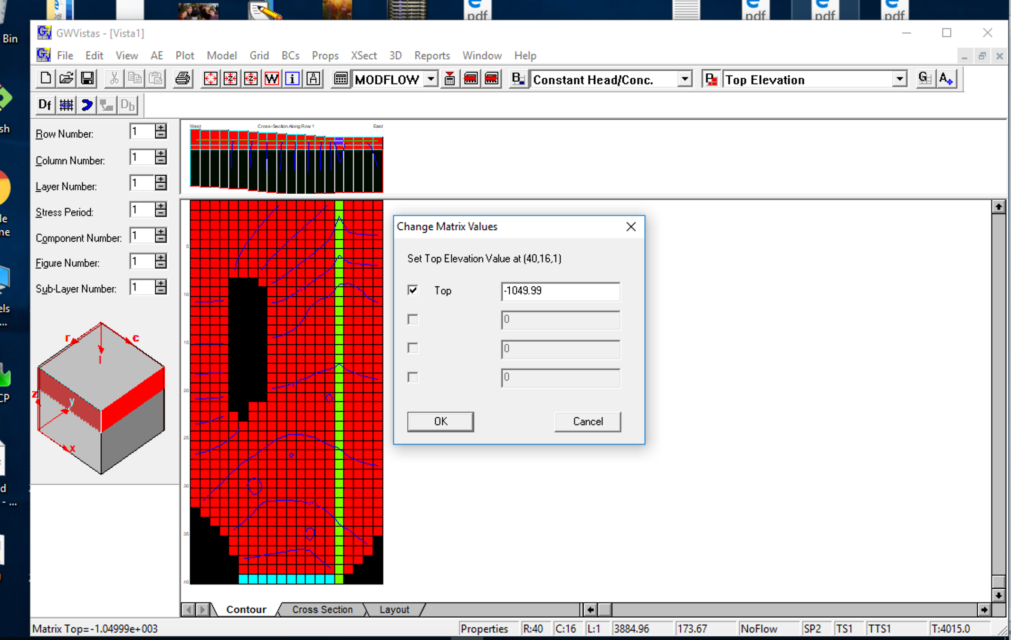

18) Last change: Fix error in TOP elevation from original model Row 40, Column 16, Col 1

